Slide 1
RDMA in Data Centers: Looking Back and Looking Forward
Chuanxiong Guo
Microsoft Research
ACM SIGCOMM APNet 2017
August 3 2017

Slide 2
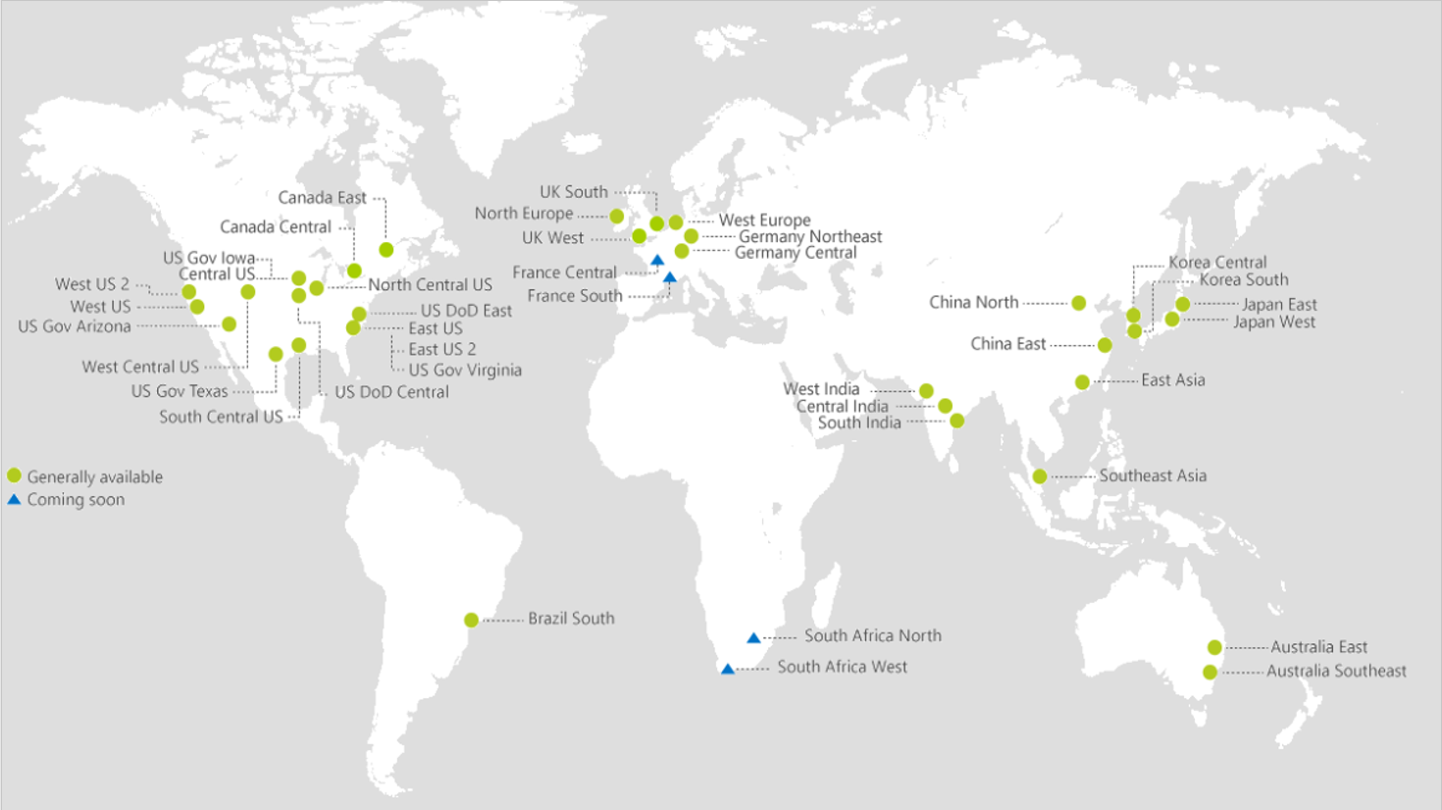
The Rising of Cloud Computing
40
AZURE REGIONS

Slide 3
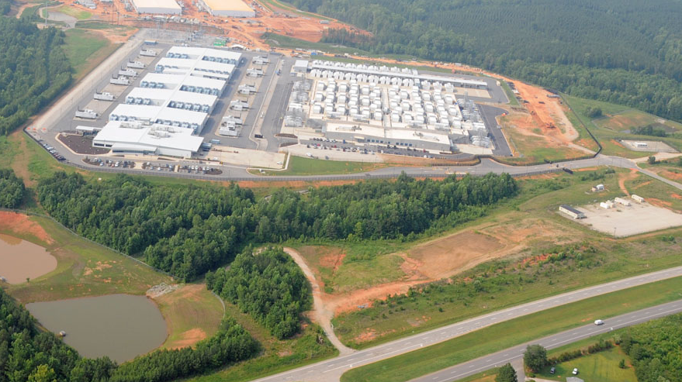
Data Centers

Slide 4
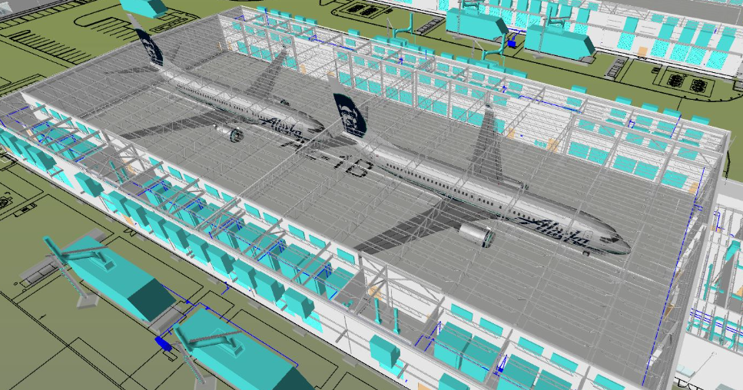
Data Centers

Slide 5
Data center networks (DCN)
Cloud scale services: IaaS, PaaS, Search, BigData, Storage, Machine Learning, Deep Learning
Services are latency sensitive or bandwidth hungry or both
Cloud scale services need cloud scale computing and communication infrastructure

Slide 6
Data center networks (DCN)
Spine
Single ownership
Large scale
High bisection bandwidth
Commodity Ethernet switches
TCP/IP protocol suite
Podset
Leaf
Pod
ToR
Servers

Slide 7
But TCP/IP is not doing well

Slide 8
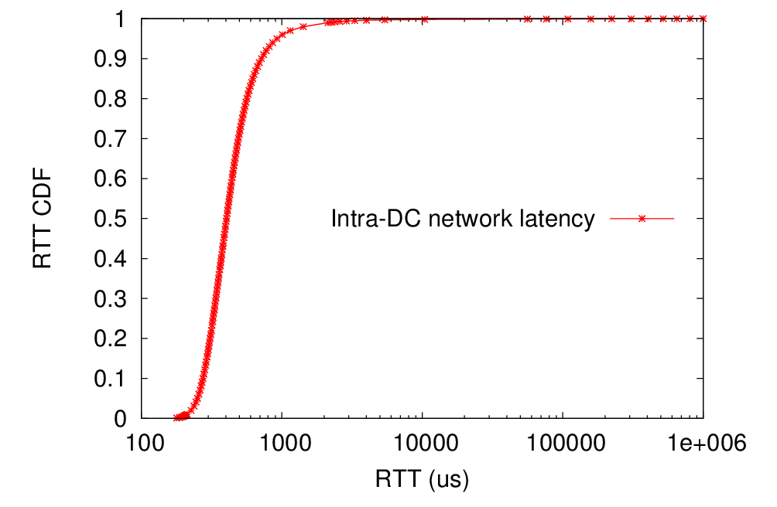
TCP latency
Long latency tail
2132us (P99)
716us (P90)
Pingmesh measurement results
405us (P50)

Slide 9
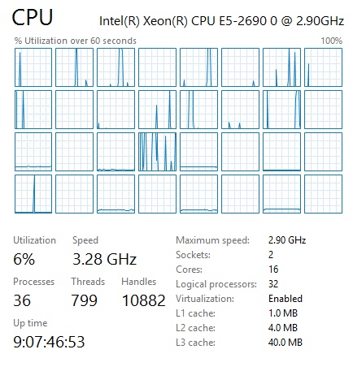
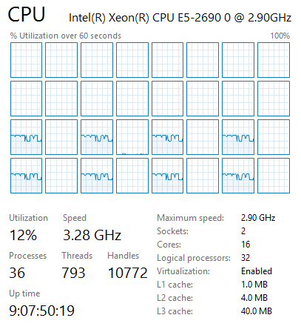
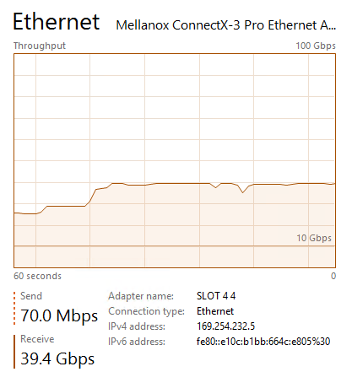
TCP processing overhead (40G)
Sender
Receiver
8 tcp connections
40G NIC

Slide 10
An RDMA renaissance story

Slide 11
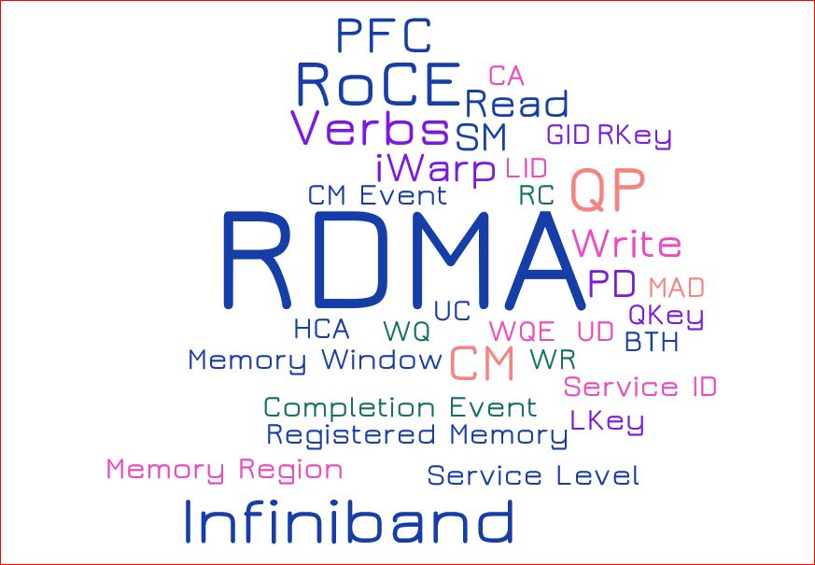
Virtual Interface Architecture Spec
1.0 1997
Infiniband Architecture Spec
1.0 2000
1.1 2002
1.2 2004
1.3 2015
RoCE 2010
RoCEv2 2014

Slide 12
RDMA
Remote Direct Memory Access (RDMA): Method of accessing memory on a remote system without interrupting the processing of the CPU(s) on that system
RDMA offloads packet processing protocols to the NIC
RDMA in Ethernet based data centers

Slide 13
RoCEv2: RDMA over Commodity Ethernet
RDMA app
RDMA app
User
RoCEv2 for Ethernet based data centers
RoCEv2 encapsulates packets in UDP
OS kernel is not in data path
NIC for network protocol processing and message DMA
RDMA verbs
RDMA verbs
TCP/IP
TCP/IP
Kernel
NIC driver
NIC driver
RDMA transport
RDMA transport
DMA
DMA
Hardware
IP
IP
Ethernet
Ethernet
Lossless network

Slide 14
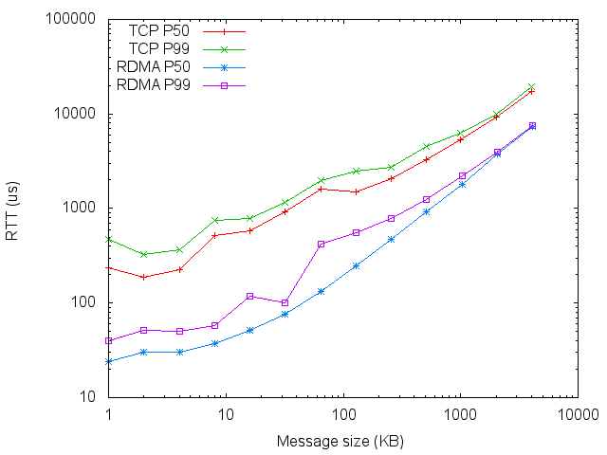
RDMA benefit: latency reduction
Msg size | TCP P50 (us) | TCP P99 (us) | RDMA P50 (us) | RDMA P99 (us)
1KB | 236 | 467 | 24 | 40
16KB | 580 | 788 | 51 | 117
128KB | 1483 | 2491 | 247 | 551
1MB | 5290 | 6195 | 1783 | 2214
For small msgs (<32KB), OS processing latency matters
For large msgs (100KB+), speed matters

Slide 15
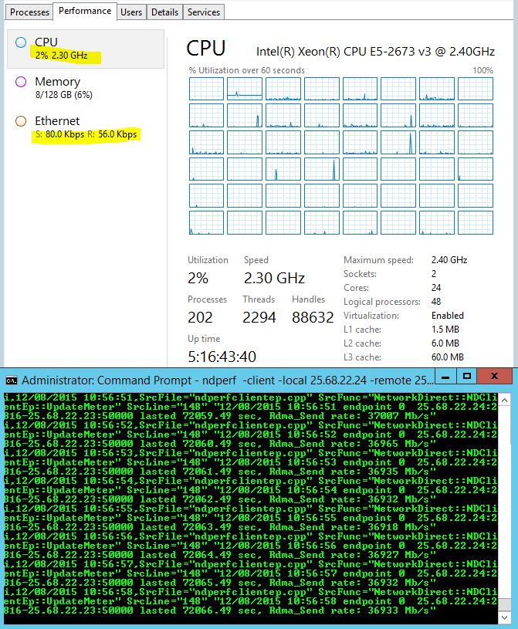
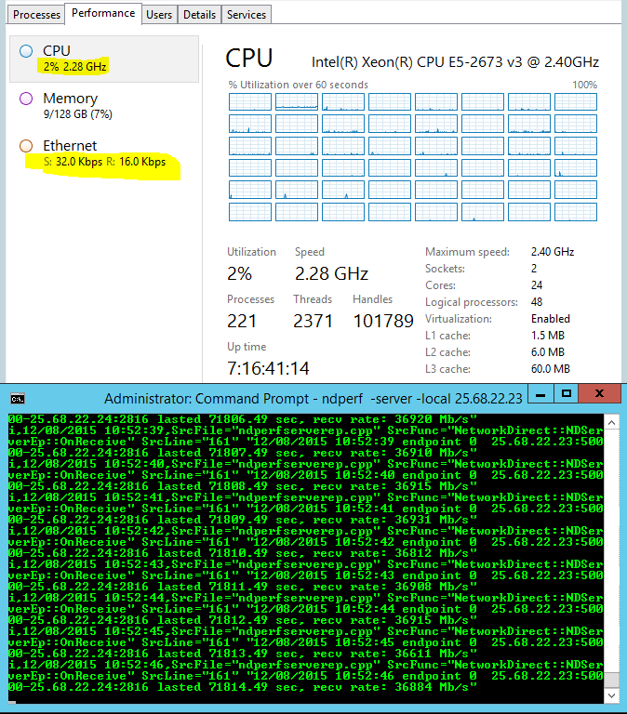
RDMA benefit: CPU overhead reduction
Sender
Receiver
One ND connection
40G NIC
37Gb/s goodput

Slide 16
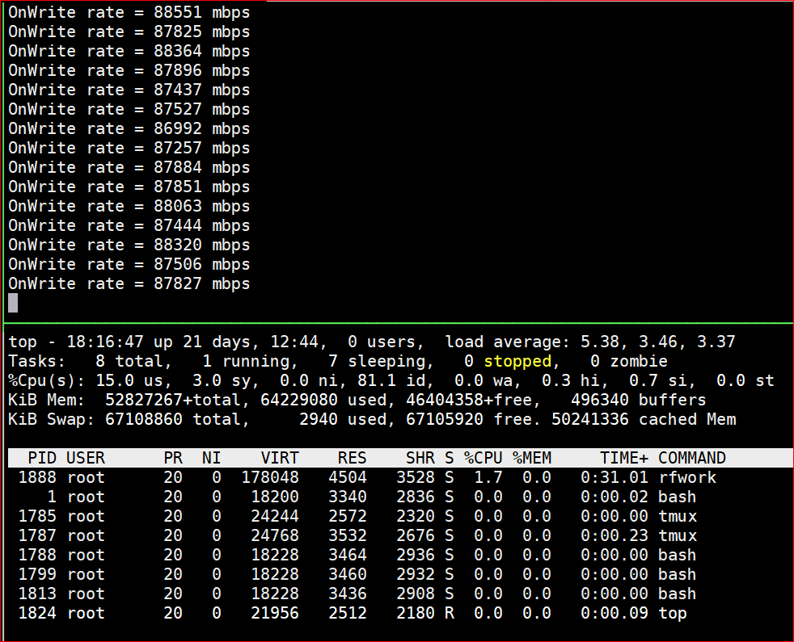
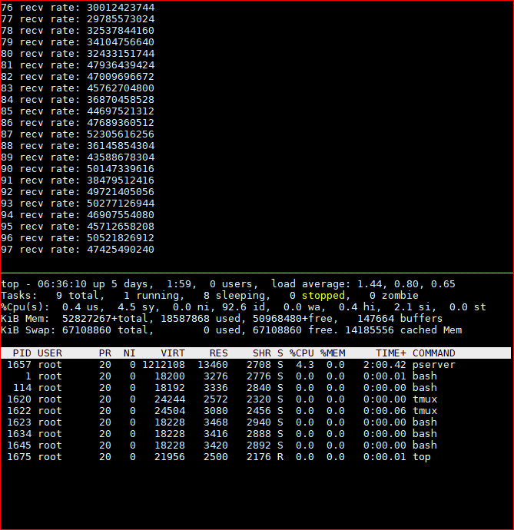
RDMA benefit: CPU overhead reduction
Intel(R) Xeon(R) CPU E5-2690 v4 @ 2.60GHz, two sockets 28 cores
RDMA: Single QP, 88 Gb/s, 1.7% CPU
TCP: Eight connections, 30-50Gb/s,
Client: 2.6%, Server: 4.3% CPU

Slide 17
RoCEv2 needs a lossless Ethernet network
PFC for hop-by-hop flow control
DCQCN for connection-level congestion control

Slide 18
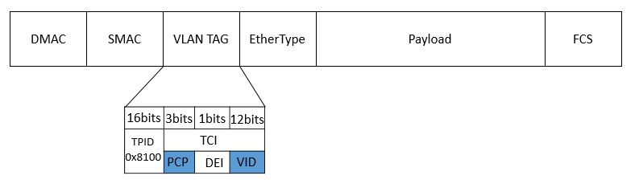

Priority-based flow control (PFC)
Egress port
Ingress port
Data packet
Hop-by-hop flow control, with eight priorities for HOL blocking mitigation
The priority in data packets is carried in the VLAN tag or DSCP
PFC pause frame to inform the upstream to stop
PFC causes HOL and colleterial damage
p0
p0
p0
p1
p1
p1
p7
PFC pause frame
p7
XOFF threshold
Data packet
PFC pause frame

Slide 19
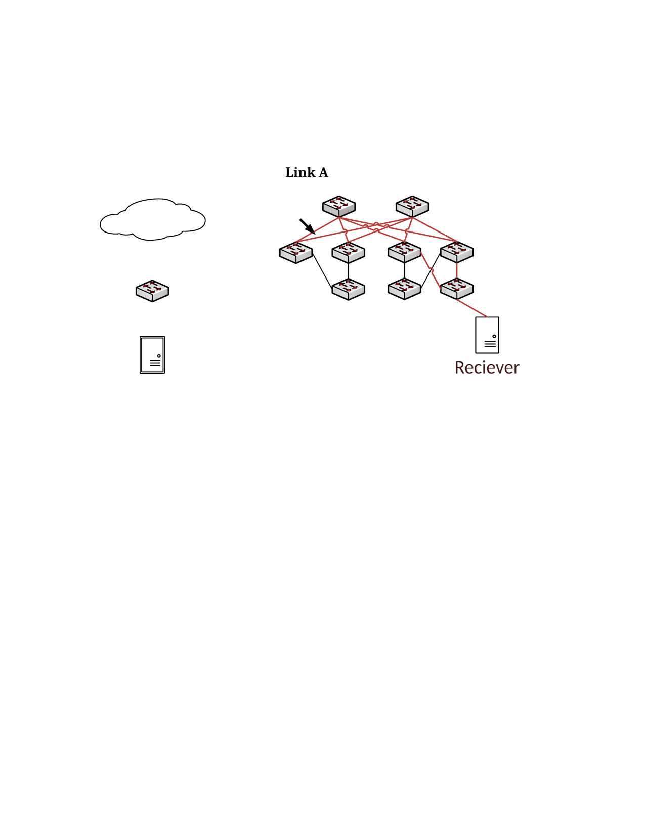
DCQCN
Sender NIC
Reaction Point
(RP)
Switch
Congestion Point (CP)
Receiver NIC
Notification Point (NP)
DCQCN = Keep PFC + Use ECN + hardware rate-based congestion control
CP: Switches use ECN for packet marking
NP: periodically check if ECN-marked packets arrived, if so, notify the sender
RP: adjust sending rate based on NP feedbacks

Slide 20
The lossless requirement causes safety and performance challenges
RDMA transport livelock
PFC deadlock
PFC pause frame storm
Slow-receiver symptom

Slide 21
RDMA transport livelock
Receiver
Sender
Receiver
Sender
RDMA Send 0
RDMA Send 0
Switch
RDMA Send 1
RDMA Send 1
Pkt drop rate 1/256
RDMA Send N+1
RDMA Send N+1
Sender
Receiver
RDMA Send N+2
RDMA Send N+2
NAK N
NAK N
RDMA Send 0
RDMA Send N
RDMA Send 1
RDMA Send N+1
RDMA Send 2
RDMA Send N+2
Go-back-0
Go-back-N

Slide 22
PFC deadlock
Our data centers use Clos network
Packets first travel up then go down
No cyclic buffer dependency for up-down routing -> no deadlock
But we did experience deadlock!
Spine
Podset
Leaf
Pod
ToR
Servers

Slide 23
PFC deadlock
Preliminaries
  ARP table: IP address to MAC address mapping
  MAC table: MAC address to port mapping
  If MAC entry is missing, packets are flooded to all ports
Input
ARP table
IP | MAC | TTL
IP0 | MAC0 | 2h
IP1 | MAC1 | 1h
MAC table
MAC | Port | TTL
MAC0 | Port0 | 10min
MAC1 | - | -
Dst: IP1
Output

Slide 24
PFC deadlock
Path: {S1, T0, La, T1, S3}
La
Lb
Path: {S1, T0, La, T1, S5}
p0
p1
p0
p1
Path: {S4, T1, Lb, T0, S2}
PFC pause frames
2
3
1
4
Congested port
p2
p3
p3
p4
Ingress
port
T0
T1
p0
p1
p0
p1
p2
Egress
port
Dead server
Packet drop
PFC pause frames
Server
S1
S2
S3
S4
S5

Slide 25
PFC deadlock
The PFC deadlock root cause: the interaction between the PFC flow control and the Ethernet packet flooding
Solution: drop the lossless packets if the ARP entry is incomplete
Recommendation: do not flood or multicast for lossless traffic

Slide 26
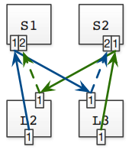
Tagger: practical PFC deadlock prevention
S0
S1
S0
S1
L0
L1
L2
L3
L0
L1
L2
L3
T0
T1
T2
T3
T0
T1
T2
T3
Tagger Algorithm works for general network topology
Deployable in existing switching ASICs
Concept: Expected Lossless Path (ELP) to decouple Tagger from routing
Strategy: move packets to different lossless queue before CBD forming

Slide 27
NIC PFC pause frame storm
Spine layer
A malfunctioning NIC may block the whole network
PFC pause frame storms caused several incidents
Solution: watchdogs at both NIC and switch sides to stop the storm
Podset 0
Podset 1
Leaf layer
ToRs
0
1
2
3
4
5
6
7
servers
Malfunctioning NIC

Slide 28
The slow-receiver symptom
ToR to NIC is 40Gb/s, NIC to server is 64Gb/s
But NICs may generate large number of PFC pause frames
Root cause: NIC is resource constrained
Mitigation
  Large page size for the MTT (memory translation table) entry
  Dynamic buffer sharing at the ToR
Server
CPU
DRAM
PCIe
Gen3 8x8 64Gb/s
QSFP
40Gb/s
WQEs
MTT
ToR
QPC
NIC
Pause frames

Slide 29
Deployment experiences and lessons learned

Slide 30
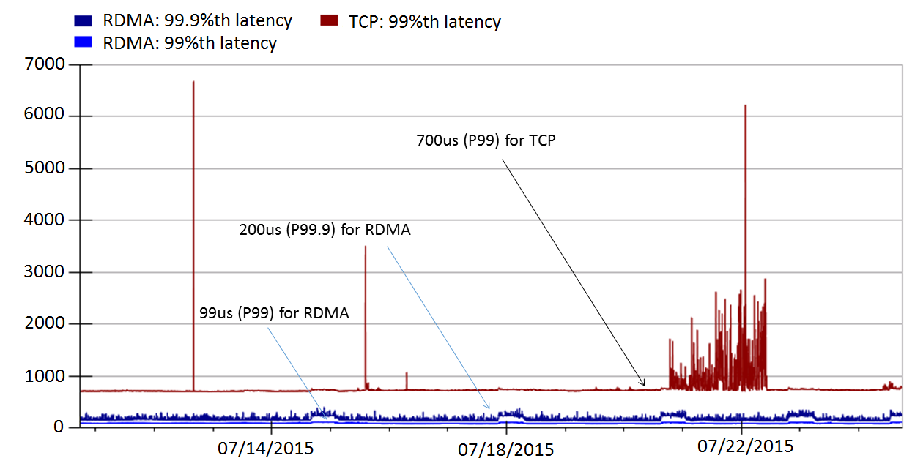
Latency reduction
RoCEv2 deployed in Bing world-wide for two and half years
Significant latency reduction
Incast problem solved as no packet drops

Slide 31
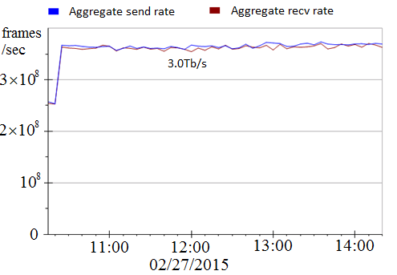
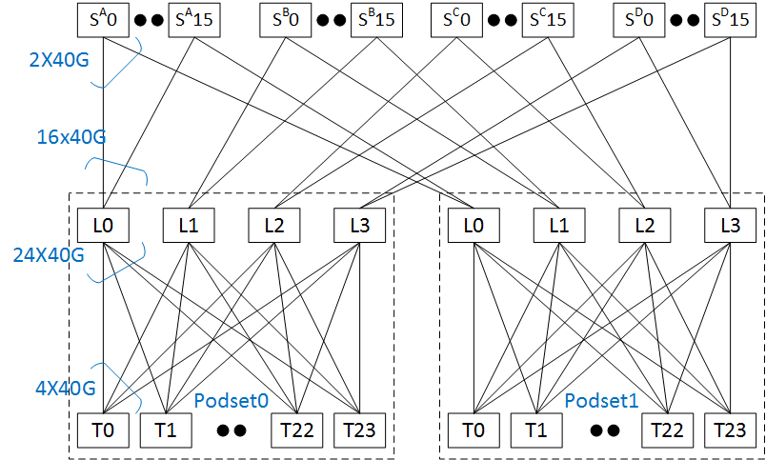
RDMA throughput
Using two podsets each with 500+ servers
5Tb/s capacity between the two podsets
Achieved 3Tb/s inter-podset throughput
Bottlenecked by ECMP routing
Close to 0 CPU overhead

Slide 32
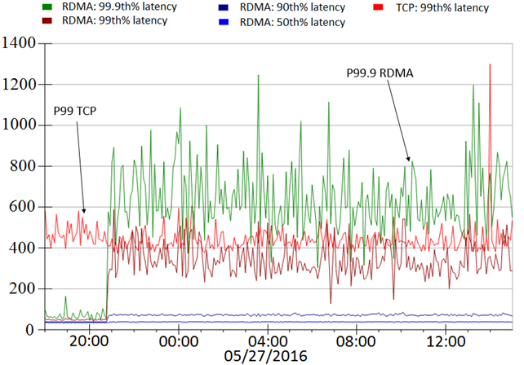
Latency and throughput tradeoff
us
L0
L1
L1
L1
T0
T1
S0,0
S0,23
S1,0
S1,23
RDMA latencies increase as data shuffling started
Low latency vs high throughput
Before data shuffling
During data shuffling

Slide 33
Lessons learned
Providing lossless is hard!
Deadlock, livelock, PFC pause frames propagation and storm did happen
Be prepared for the unexpected
  Configuration management, latency/availability, PFC pause frame, RDMA traffic monitoring
NICs are the key to make RoCEv2 work

Slide 34
What’s next?

Slide 35
Applications
Architectures
Software vs hardware
RDMA for X (Search, Storage, HFT, DNN, etc.)
Lossy vs lossless network
RDMA for heterogenous computing systems
Technologies
Protocols
RDMA programming
Practical, large-scale deadlock free network
RDMA virtualization
RDMA security
Reducing colleterial damage
Inter-DC RDMA

Slide 36
Will software win (again)?
Historically, software based packet processing won (multiple times)
  TCP processing overhead analysis by David Clark, et al.
  Non of the stateful TCP offloading took off (e.g., TCP Chimney)
The story is different this time
  Moore’s law is ending
  Accelerators are coming
  Network speed keep increasing
  Demands for ultra low latency are real

Slide 37
Is lossless mandatory for RDMA?
There is no binding between RDMA and lossless network
But implementing more sophisticated transport protocol in hardware is a challenge

Slide 38
RDMA virtualization for the container networking
A router acts as a proxy for the containers
Shared memory for improved performance
Zero copy possible

Slide 39
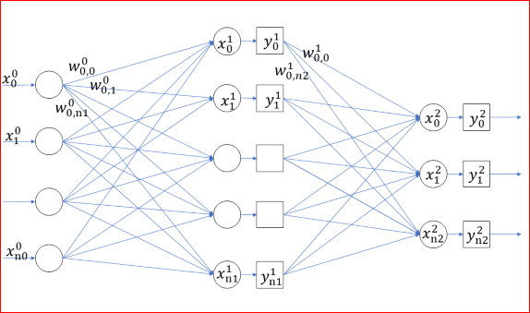
RDMA for DNN
TCP does not work for distributed DNN training
For 16-GPU, 2-host speech training with CNTK, TCP communications dominant the training time (72%), RDMA is much faster (44%)

Slide 40
RDMA Programming
How many LOC for a “hello world” communication using RDMA?
For TCP, it is 60 LOC for client or server code
For RDMA, it is complicated …
  IBVerbs: 600 LOC
  RCMA CM: 300 LOC
  Rsocket: 60 LOC

Slide 41
RDMA Programming
Make RDMA programming more accessible
  Easy-to-setup RDMA server and switch configurations
  Can I run and debug my RDMA code on my desktop/laptop?
  High quality code samples
Loosely coupled vs tightly coupled (Send/Recv vs Write/Read)

Slide 42
Summary: RDMA for data centers!
RDMA is experiencing a renaissance in data centers
  RoCEv2 has been running safely in Microsoft data centers for two and half years
Many opportunities and interesting problems for high-speed, low-latency RDMA networking
Many opportunities in making RDMA accessible to more developers

Slide 43
Acknowledgement
Yan Cai, Gang Cheng, Zhong Deng, Daniel Firestone, Juncheng Gu, Shuihai Hu, Hongqiang Liu, Marina Lipshteyn, Ali Monfared, Jitendra Padhye, Gaurav Soni, Haitao Wu, Jianxi Ye, Yibo Zhu
Azure, Bing, CNTK, Philly collaborators
Arista Networks, Cisco, Dell, Mellanox partners

Slide 44
Questions?

