Slide 1

Accelerating Distributed DNN Training
Chuanxiong Guo
ChinaSys 2019
2019-05-17

Slide 2
Outline
DNN Background
RDMA for DNN Training Acceleration
Bytedance Tensor Scheduler: ByteScheduler
Summary

Slide 3

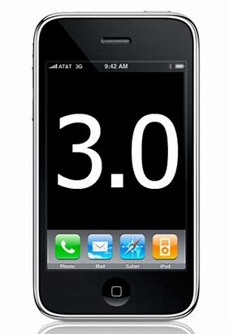


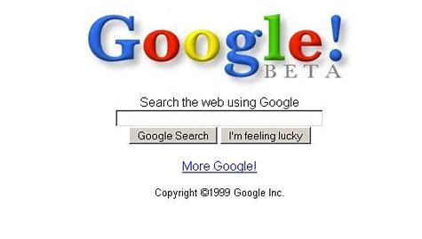

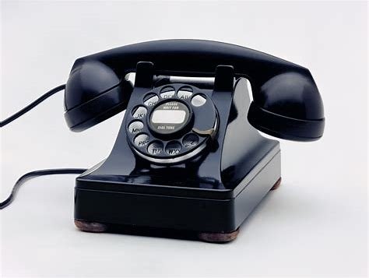
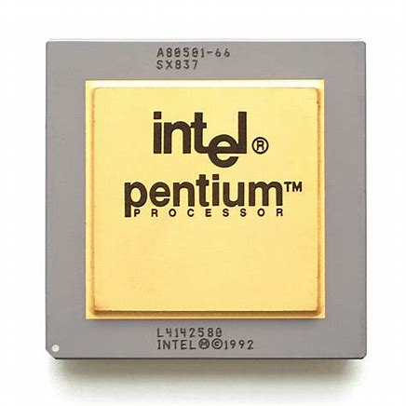
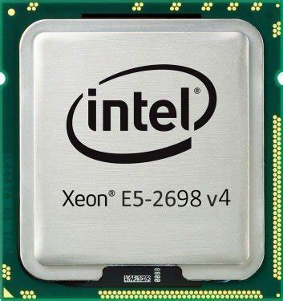
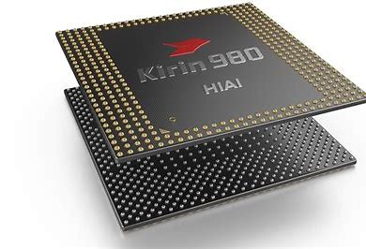
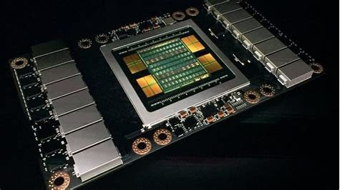
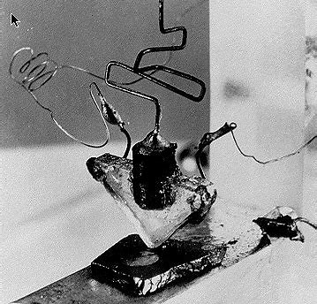
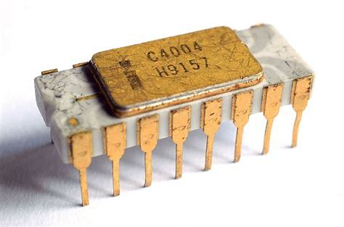
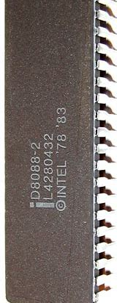


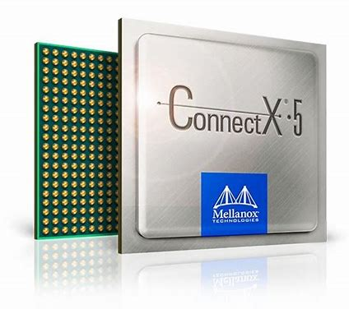
Application
Web
Browser
Mobile
Internet
Cloud
Computing
ML
system
PSTN
Cellular
TCP/IP
Windows
Linux
System
Hardware

Slide 4
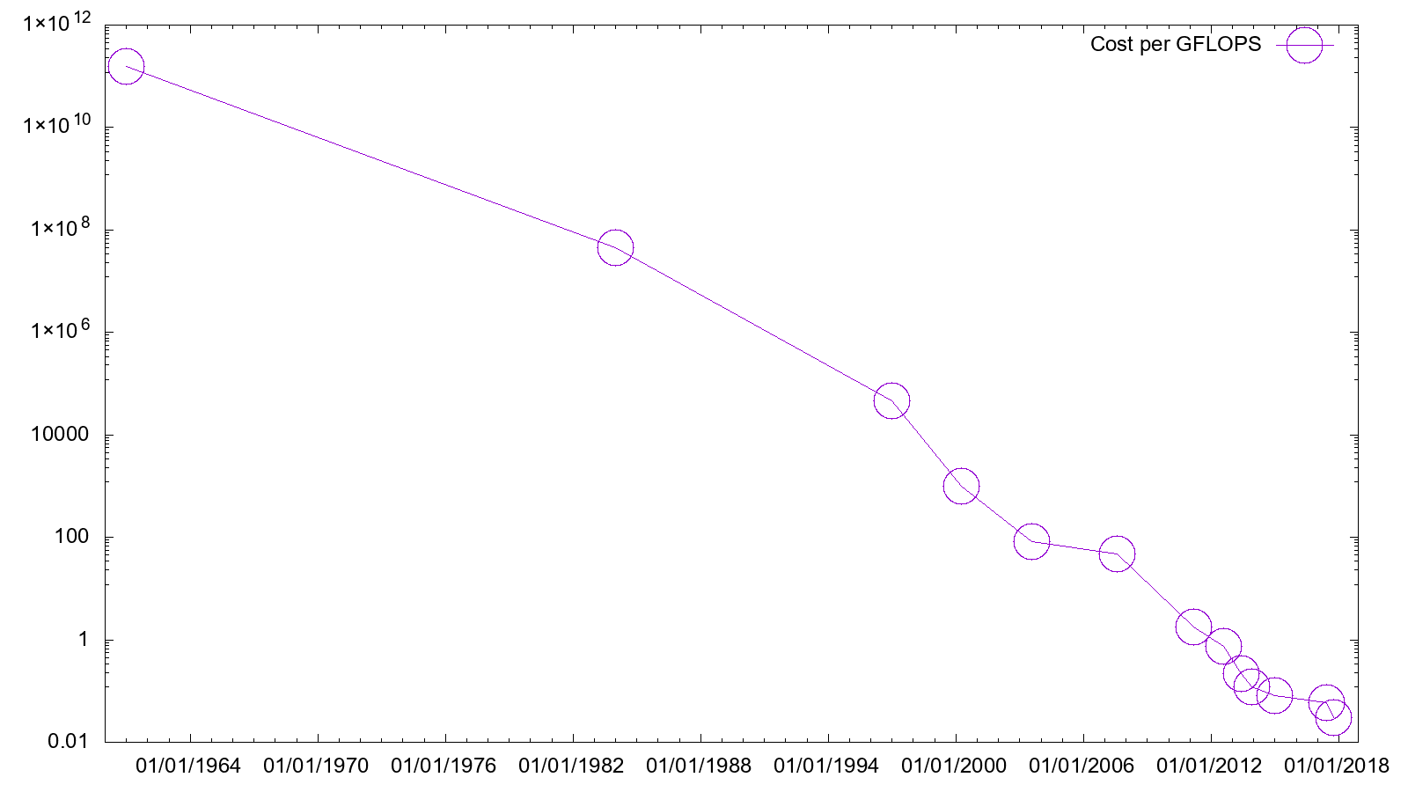
(2018 US dollars)
https://en.wikipedia.org/wiki/FLOPS
$

Slide 5
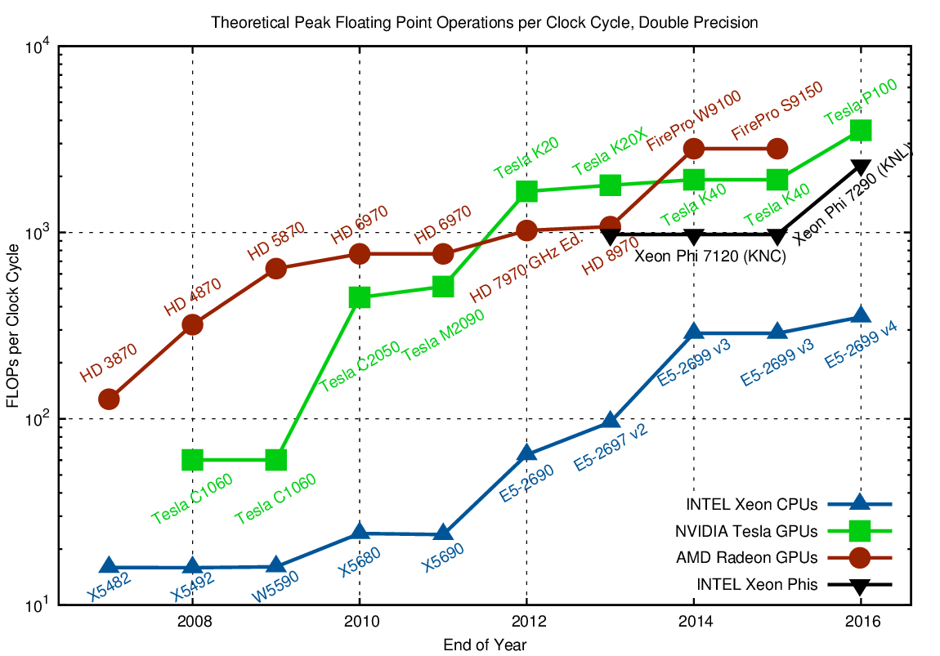
https://www.karlrupp.net/2016/08/flops-per-cycle-for-cpus-gpus-and-xeon-phis/
Notes:
Flops_per_clock_cycle:
https://www.karlrupp.net/2016/08/flops-per-cycle-for-cpus-gpus-and-xeon-phis/
The Radeon HD 8970 OEM was a graphics card by AMD, launched in January 2013. Built on the 28 nm process, and based on the Tahiti graphics processor
The AMD FirePro S9150 is the industry's first server GPU with 16GB ultra-fast GDDR5 onboard memory

Slide 6
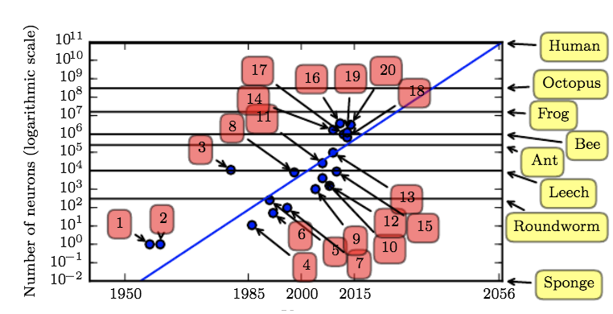
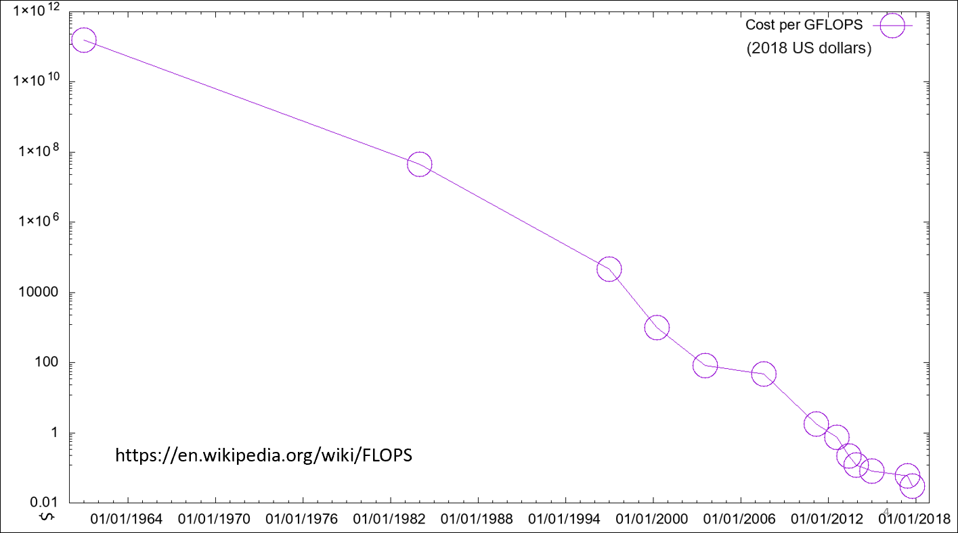
Notes:
1. Perceptron (Rosenblatt, 1958, 1962)
2. Adaptive linear element (Widrow and Hoff, 1960)
3. Neocognitron (Fukushima, 1980)
4. Early back-propagation network (Rumelhart et al., 1986b)
5. Recurrent neural network for speech recognition (Robinson and Fallside, 1991)
6. Multilayer perceptron for speech recognition (Bengio et al., 1991)
7. Mean field sigmoid belief network (Saul et al., 1996)
8. LeNet-5 (LeCun et al., 1998b)
9. Echo state network (Jaeger and Haas, 2004)
10. Deep belief network (Hinton et al., 2006)
11. GPU-accelerated convolutional network (Chellapilla et al., 2006)
12. Deep Boltzmann machine (Salakhutdinov and Hinton, 2009a)
13. GPU-accelerated deep belief network (Raina et al., 2009)
14. Unsupervised convolutional network (Jarrett et al., 2009)
15. GPU-accelerated multilayer perceptron (Ciresan et al., 2010)
16. OMP-1 network (Coates and Ng, 2011)
17. Distributed autoencoder (Le et al., 2012)
18. Multi-GPU convolutional network (Krizhevsky et al., 2012)
19. COTS HPC unsupervised convolutional network (Coates et al., 2013)
20. GoogLeNet (Szegedy et al., 2014a)

Slide 7
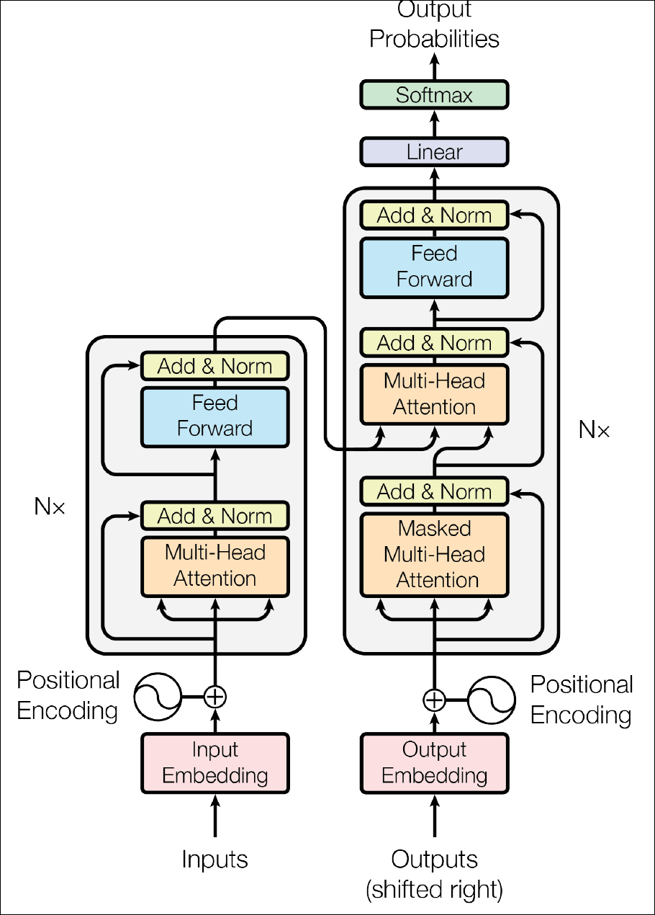
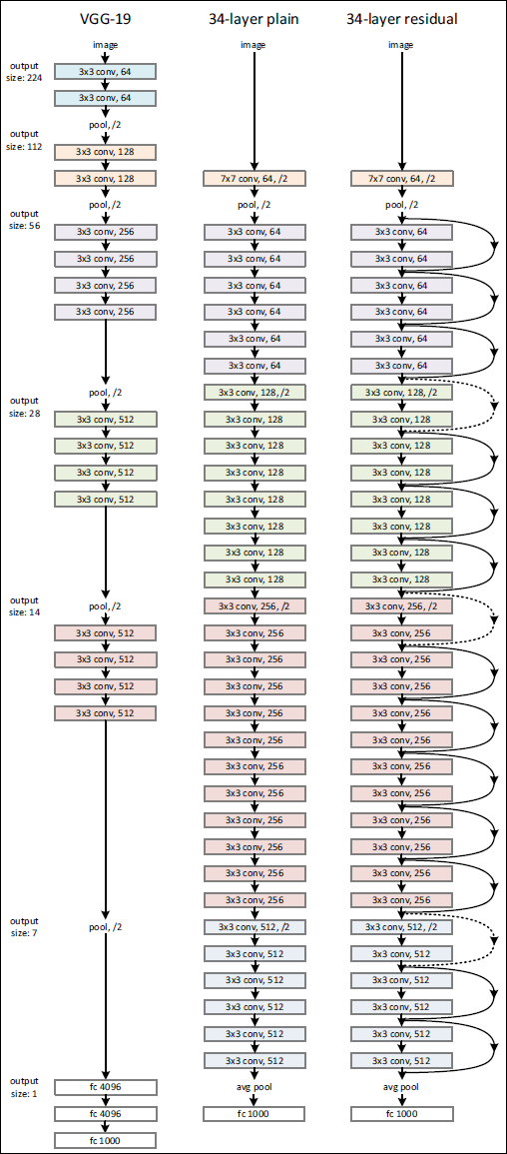
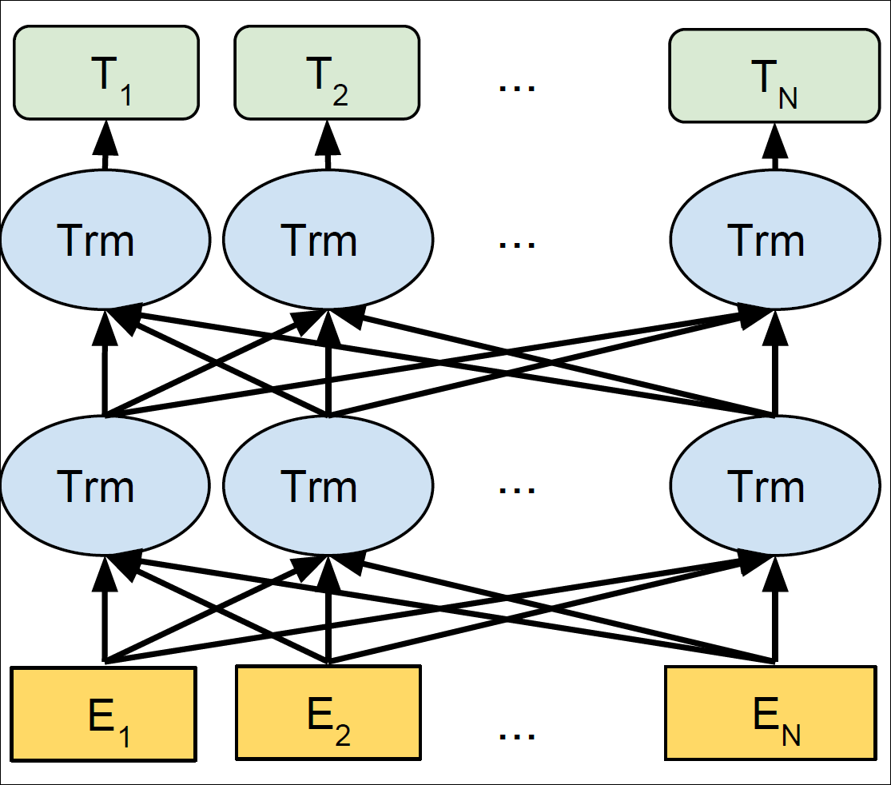
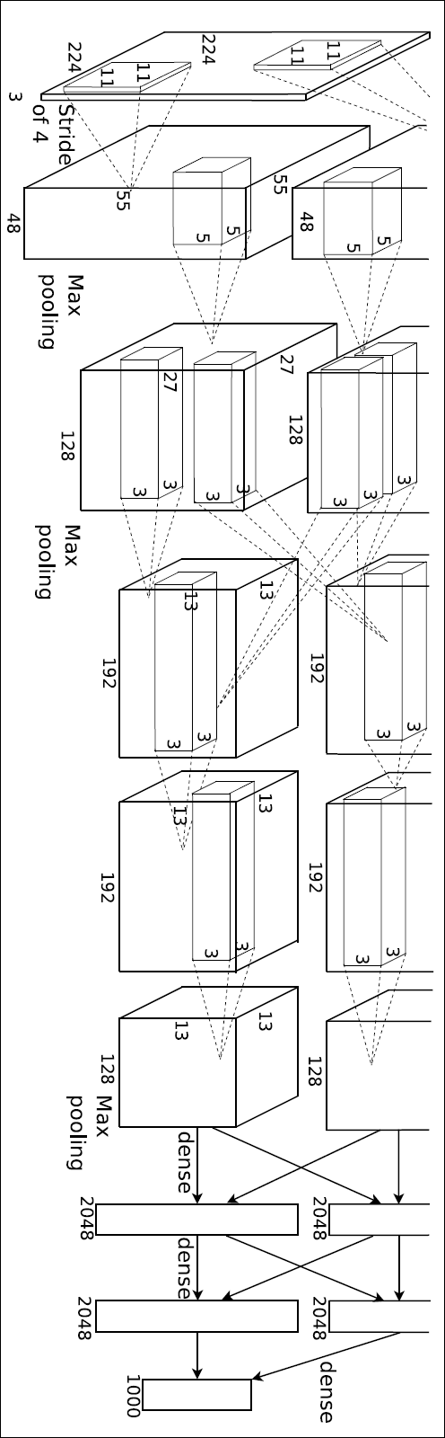
DNN Models
AlexNet
VGG ResNet
Transformer
Bert pre-training
Notes:
Alexnet has 8 layers, 5 conv, 3 fc.
With neurons: 622312
Resnet50: number of neurons: 9083904
bert base's total params: 100896768
bert base's total neurons: 147456
bert large's total params: 307544064
bert large's total neurons: 393216

Slide 8

Back Prop based DNN Training
Epoch0
Epoch1
Epoch2
Epoch3
Epoch M
Training
Minibatch0
Minibatch1
Minibatch2
Minibatch N
Forward
Backward
f_0
f_1
…
f_{n-1}
b_{n-1}
b_{n-2}
…
b_0
s_{n-1}
g_{n-1}
s_{n-2}
g_{n-2}
…
s_0
g_0
Notes:
Epoch
Minibatch
Forward backward, gradient update.

Slide 9
Distributed DNN Training
worker
worker
worker
worker
worker
Parameter Server
All-reduce
Notes:
Two typical ways of distributed dnn training. PS model, and all-reduce model.

Slide 10
DNN Models
Model (dataset) | Resnet50(imagenet) | VGG16(imagenet) | Transformer(WMT17) | Bert base | Bert large
Model param# (M) | 26 | 138 | 61 | 148 | 387
GFlops FP (batch size 1) | 3.9 | 16 | 37 | 52 | 170
GFlops BP (batch size 1) | 3.9 | 16 | 37 | 97 | 324
Time for FP (ms) | 7 (batch1) 32 (batch32) | 5 (batch1) 49 (batch32) | 5 (batch1) 95 (batch16) | 13 (batch1) 188 (batch85) | 22 (batch1) 339 (batch35)
Time for BP (ms) | 14 (batch1) 64 (batch32) | 11 (batch1) 100 (batch32) | 14 (batch1) 114 (batch16) | 42 (batch1) 281 (batch85) | 102 (batch1) 508 (batch35)
Ideal comm. time (ms), 100GbE | 8.32 | 44.6 | 19.52 | 23.68 | 61.92
#Iter. to converge | 450k(total batch size 256) | 370k (total batch size 256) | 100k (total batch size 4096) | 125k (64 V100) | 125k (64 V100)
Data shuffled for convergence (TB) | 46.8 (fp32) | 204 (fp32) | 24 (fp16) | 37 (fp16) | 97 (fp16)
Notes:
Model sizes are becoming larger
Computational power needs are increasing
Moving a lot of data
Computation and communication are somewhat balanced
We got the result on V100
Data shuffled is for a single worker.
Need to shuffle a lot of data.
Communication and computation all take around tens to hundreds of milliseconds in one iteration.

Slide 11
DNN Models
Model (dataset) | Resnet50(imagenet) | VGG16(imagenet) | Transformer(WMT17) | Bert base | Bert large
Model param# (M) | 26 | 138 | 61 | 148 | 387
GFlops FP (batch size 1) | 3.9 | 16 | 37 | 52 | 170
GFlops BP (batch size 1) | 3.9 | 16 | 37 | 97 | 324
Time for FP (ms) | 7 (batch1) 32 (batch32) | 5 (batch1) 49 (batch32) | 5 (batch1) 95 (batch16) | 13 (batch1) 188 (batch85) | 22 (batch1) 339 (batch35)
Time for BP (ms) | 14 (batch1) 64 (batch32) | 11 (batch1) 100 (batch32) | 14 (batch1) 114 (batch16) | 42 (batch1) 281 (batch85) | 102 (batch1) 508 (batch35)
Ideal comm. time (ms), 100GbE | 8.32 | 44.6 | 19.52 | 23.68 | 61.92
#Iter. to converge | 450k(total batch size 256) | 370k (total batch size 256) | 100k (total batch size 4096) | 125k (64 V100) | 125k (64 V100)
Data shuffled for convergence (TB) | 46.8 (fp32) | 204 (fp32) | 24 (fp16) | 37 (fp16) | 97 (fp16)
Models need more and more computational power
DNN training needs to shuffle huge amount of data
Different models have different communication/computation ratio
Training is a mechanical, iterative process
Notes:
Model sizes are becoming larger
Computational power needs are increasing
Moving a lot of data
Computation and communication are somewhat balanced
We got the result on V100
Data shuffled is for a single worker.
Need to shuffle a lot of data.
Communication and computation all take around tens to hundreds of milliseconds in one iteration.

Slide 12
DNN Training Acceleration
Optimization algorithm improvement
Computation acceleration
  More powerful computing devices
  Graph execution optimization
  Mixed precision training
Communication acceleration
  RDMA
  Compression
Overlap communication with computation
  Bytedance Tensor Scheduler (ByteScheduler)
Notes:
We focus on two technologies:
Using RDMA to accelerate computer communication,
And we study the detailed structure of dnn training, which reveals that we can accelerate dnn training by better overlap computation and communication.

Slide 13
Outline
DNN Background
RDMA for DNN Training Acceleration
Bytedance Tensor Scheduler (ByteScheduler)
Summary

Slide 14
RDMA
Remote Direct Memory Access (RDMA): Method of accessing memory on a remote system without interrupting the processing of the CPU(s) on that system
RDMA offloads packet processing protocols to the NIC
IBVerbs/NetDirect for RDMA programing
RDMA in Ethernet based data centers (RoCEv2)
Notes:
Why CPUs upgrade more frequently than communication rate?
Why we need rdma?

Slide 15
RoCEv2: RDMA over Commodity Ethernet
RDMA app
RDMA app
User
RoCEv2 for Ethernet based data centers
DSCP-based PFC for lossless networking
DCQCN for flow-based congestion control
Huge engineering efforts to make it scalable and safe
RDMA verbs
RDMA verbs
TCP/IP
TCP/IP
Kernel
NIC driver
NIC driver
RDMA transport
RDMA transport
DMA
DMA
Hardware
IP
IP
Ethernet
Ethernet
Lossless network

Slide 16
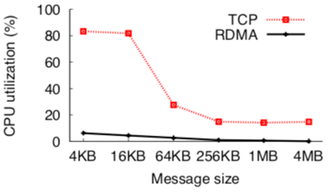
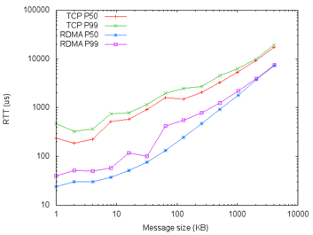
Using RDMA for Communication
RDMA NIC Offloading: ~0% CPU usage
RDMA Latency benefits (lower latency than TCP)
  Kernel bypassing
  Fast start / Lossless networking / ACK consolidation
~0% CPU Usage
Lower latency compared to TCP

Slide 17
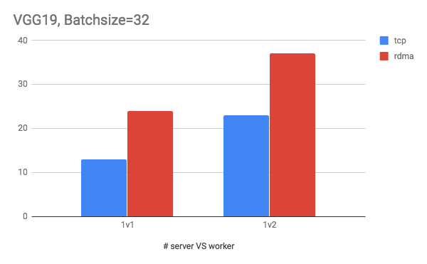
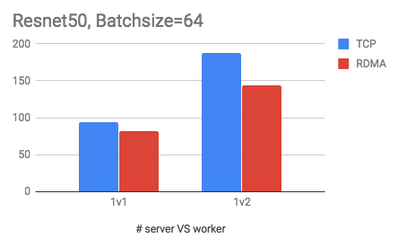
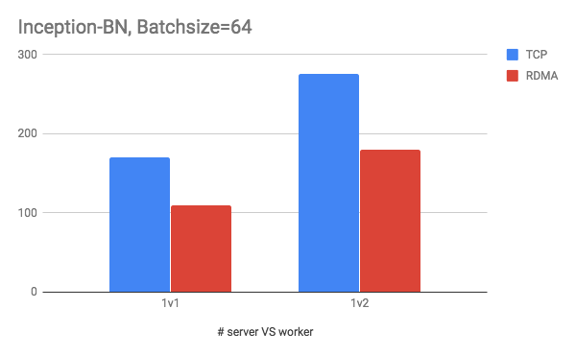
Vanilla RDMA Does Not Perform Well
For large models, vanilla RDMA outperforms TCP
  VGG19 has some large tensors (hundreds of MB), making the overhead not evident
For small models, vanilla RDMA is worse than TCP
  Resnet50 and Inception-BN have a lot of small tensors (most of them no more than 1MB)
  The overhead is larger than the benefit that RDMA brings

Slide 18
Optimizing RDMA for DNN Training
Our optimizations on RDMA performance
Tensor buffer memory reuse
One-way RDMA write
Zero-copy RDMA data path

Slide 19
Tensor Buffer Memory Reuse
RDMA message needs to be registered before sent
Reuse the tensor memory region
  i.e., the sending buffer memory address can be reused
  we only need to do reg_mr once in the first training iteration, and reuse the memory in all the following iterations
  can benefit frameworks that decouple memory allocation with its communication library (e.g., MXNet & ps-lite)
iteration-0
compute
reg_mr
post_send
update
Vanilla
iteration-1
compute
reg_mr
post_send
update
iteration-0
compute
reg_mr
post_send
update
Optimized
iteration-1
compute
post_send
update
Notes:
DNN training is repetitive.

Slide 20
One-way RDMA-write
Reduce redundant rendezvous latency
  Rendezvous: get the remote buffer address to write the data
  With memory reuse, we only need Rendezvous once, and remove redundant rendezvous because the remote memory address does not change
sender
receiver
sender
receiver
1. Rendezvous Start
1. Rendezvous Start
2. Rendezvous Reply
Remove repeated rendezvous
2. Rendezvous Reply
3. Data RDMA-write
3. Data RDMA-write
Vanilla
Optimized
Notes:
Rendezvous is needed in Vanilla because every time the memory is newly allocated and registered.

Slide 21
Zero-copy RDMA Data Path
There exists several memory copies on the data path
  Worker sends push requests to server, server copies the result to CPU buffer
  Server sends pull responses to worker, worker copies to CPU buffer
Memory copy decreases performance
  Single-threaded memcpy bandwidth: ~40Gbps
  Memcpy significantly decreases RDMA bandwidth utilization
We remove all memcpy on RDMA data-path, and achieve zero-copy communication

Slide 22
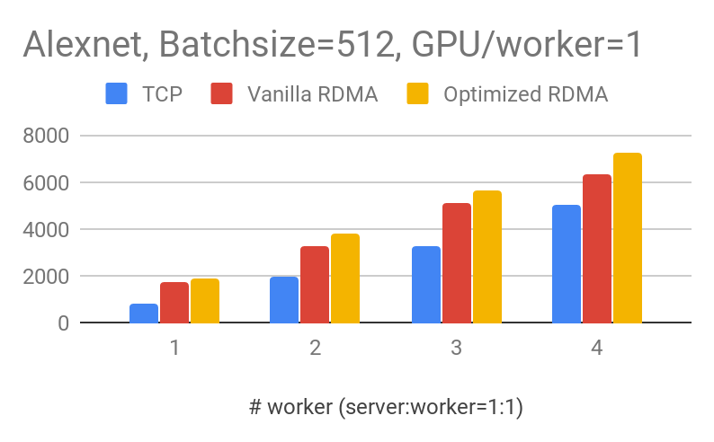
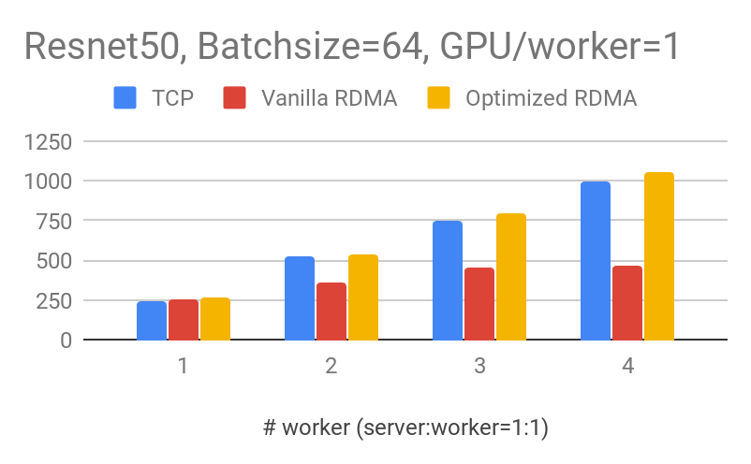
Comparison with TCP/Vanilla-RDMA
For both large (Alexnet) and small model (Resnet50), our optimized RDMA outperforms TCP and vanilla-RDMA
Notes:
one worker one gpu.

Slide 23
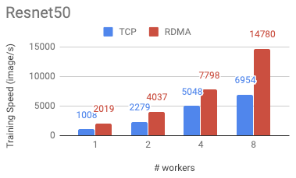
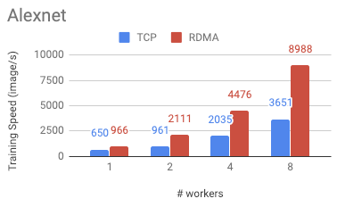
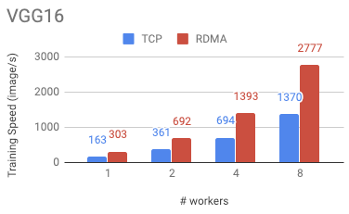
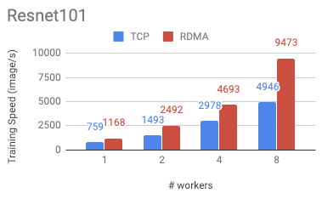
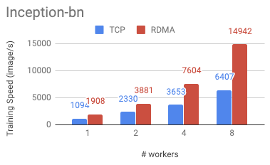
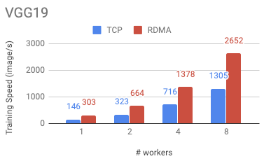
RDMA Performance on Popular Models
Batch size/GPU=32, fp32, each worker has 8 V100-GPUs
# ps = # worker
Notes:
One worker with 8 gpus

Slide 24
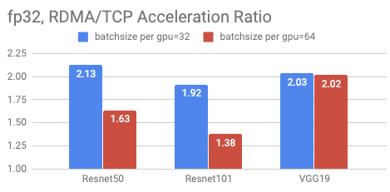
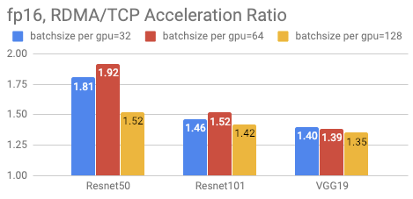
RDMA Performance under Different Setup
RDMA outperforms TCP in all our tested scenarios:
Different models / batch size/ float point accuracy
Notes:
64cards，8 servers

Slide 25
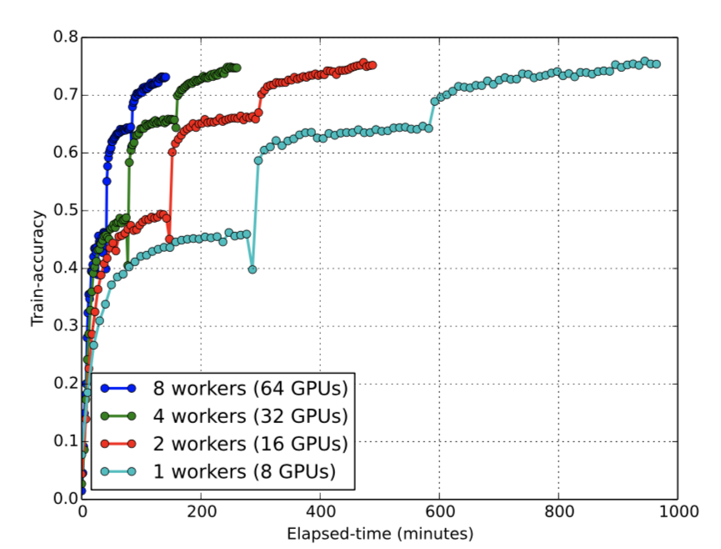
Linear Speedup: ResNet Training
With RDMA, we train Resnet50 using ImageNet, and it can converge to 70% accuracy in 2 hours using 64 V100-GPUs.
Linear scaling for Resnet50 training

Slide 26
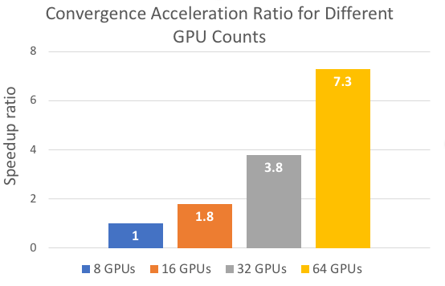
Linear Speedup: Bert Training
Linear scaling for Bert base training
Near-linear parallel speedup for BERT-base
Converge in 15 hours with 64 V100 GPUs
Before optimization, 8-GPU version using PS would need 15 days

Slide 27
Outline
DNN Background
RDMA for DNN Training Acceleration
Bytedance Tensor Scheduler (ByteScheduler)
Summary

Slide 28
Dependency Graph
      Dependency:
      Backward depends on forward
      Push depends on backward
      Pull depends on push
      Forward depends on pull

Slide 29
Scheduling the Tensor Transmission Order
ML framework executes communication operations in FIFO order
Problem: FIFO strategy delays push and pull of layer 0 and hence delays the start of next iteration
Priority scheduling: layer i with higher priority than j for i < j

Slide 30
Priority Scheduling and Tensor Partitioning
In this example, priority scheduling and tensor partition result in 44% speedup

Slide 31
One Unified Scheduling System for ALL
Dependency graphs have similar structure for different ML frameworks, DNN models and communication methods (PS or all-reduce, TCP or RDMA)
We aim to design a generic scheduler, no matter which ML framework and communication method.
Challenges:
Many training frameworks: TensorFlow, PyTorch, MxNet, etc.
Imperative engines (e.g., PyTorch) and declarative engines (e.g., TensorFlow)
Global barrier between iterations (e.g., TensorFlow, PyTorch)

Slide 32
Dependency Graph: Tensorflow
A global barrier exists between iterations, causing any scheduling of push/all-reduce ineffective.

Slide 33
ByteScheduler Overview

Slide 34
Unified Abstraction for Communication Tasks
A unified abstraction for communication operations, called Task
Task APIs:
partition(size): partition a Task into small ones with tensors no larger than size
notify_ready(): notify Core about a tensor being ready to send
start(): call the underlying push/pull/all-reduce to start a tensor
notify_finish(): notify Core about the completion of a Task so that Core can schedule more Tasks

Slide 35
Interaction with Framework Engines
A Dependency Proxy is an operation created by ByteScheduler to claim dependencies from/to other operations.
The Proxy does 3 things:
              Trigger Task.notify_ready() via a callback.
Wait until Core calls Task.start().
Generate completion signal using Task.notify_finish().

Slide 36
Crossing the Global Barrier
Two steps:
Remove dependencies on global barrier.
Build layer-wise dependencies.

Slide 37
Crossing the Global Barrier
Out-of-engine communication: replace original communication operator with an async op which starts the actual communication outside engine
Layer-wise out-of-engine dependencies: add a Proxy before the forward propagation of each layer and block it until Core gets Task.notify_finish() to ensure correct cross-iteration dependencies.

Slide 38
Evaluation Methodology
Testbed: 16 machines, each with 8 V100 GPUs and a 100Gbps NIC
Benchmarks: VGG16, ResNet50, Transformer
Settings: MXNet PS TCP, MXNet PS RDMA, TensorFlow PS TCP, MXNet NCCL RDMA, PyTorch NCCL TCP
Baselines:
  Vanilla ML frameworks
  Linear scaling: vanilla training speed on 1 machine multiplied by the number of machines
Metric: training speed (samples/sec or tokens/sec)

Slide 39
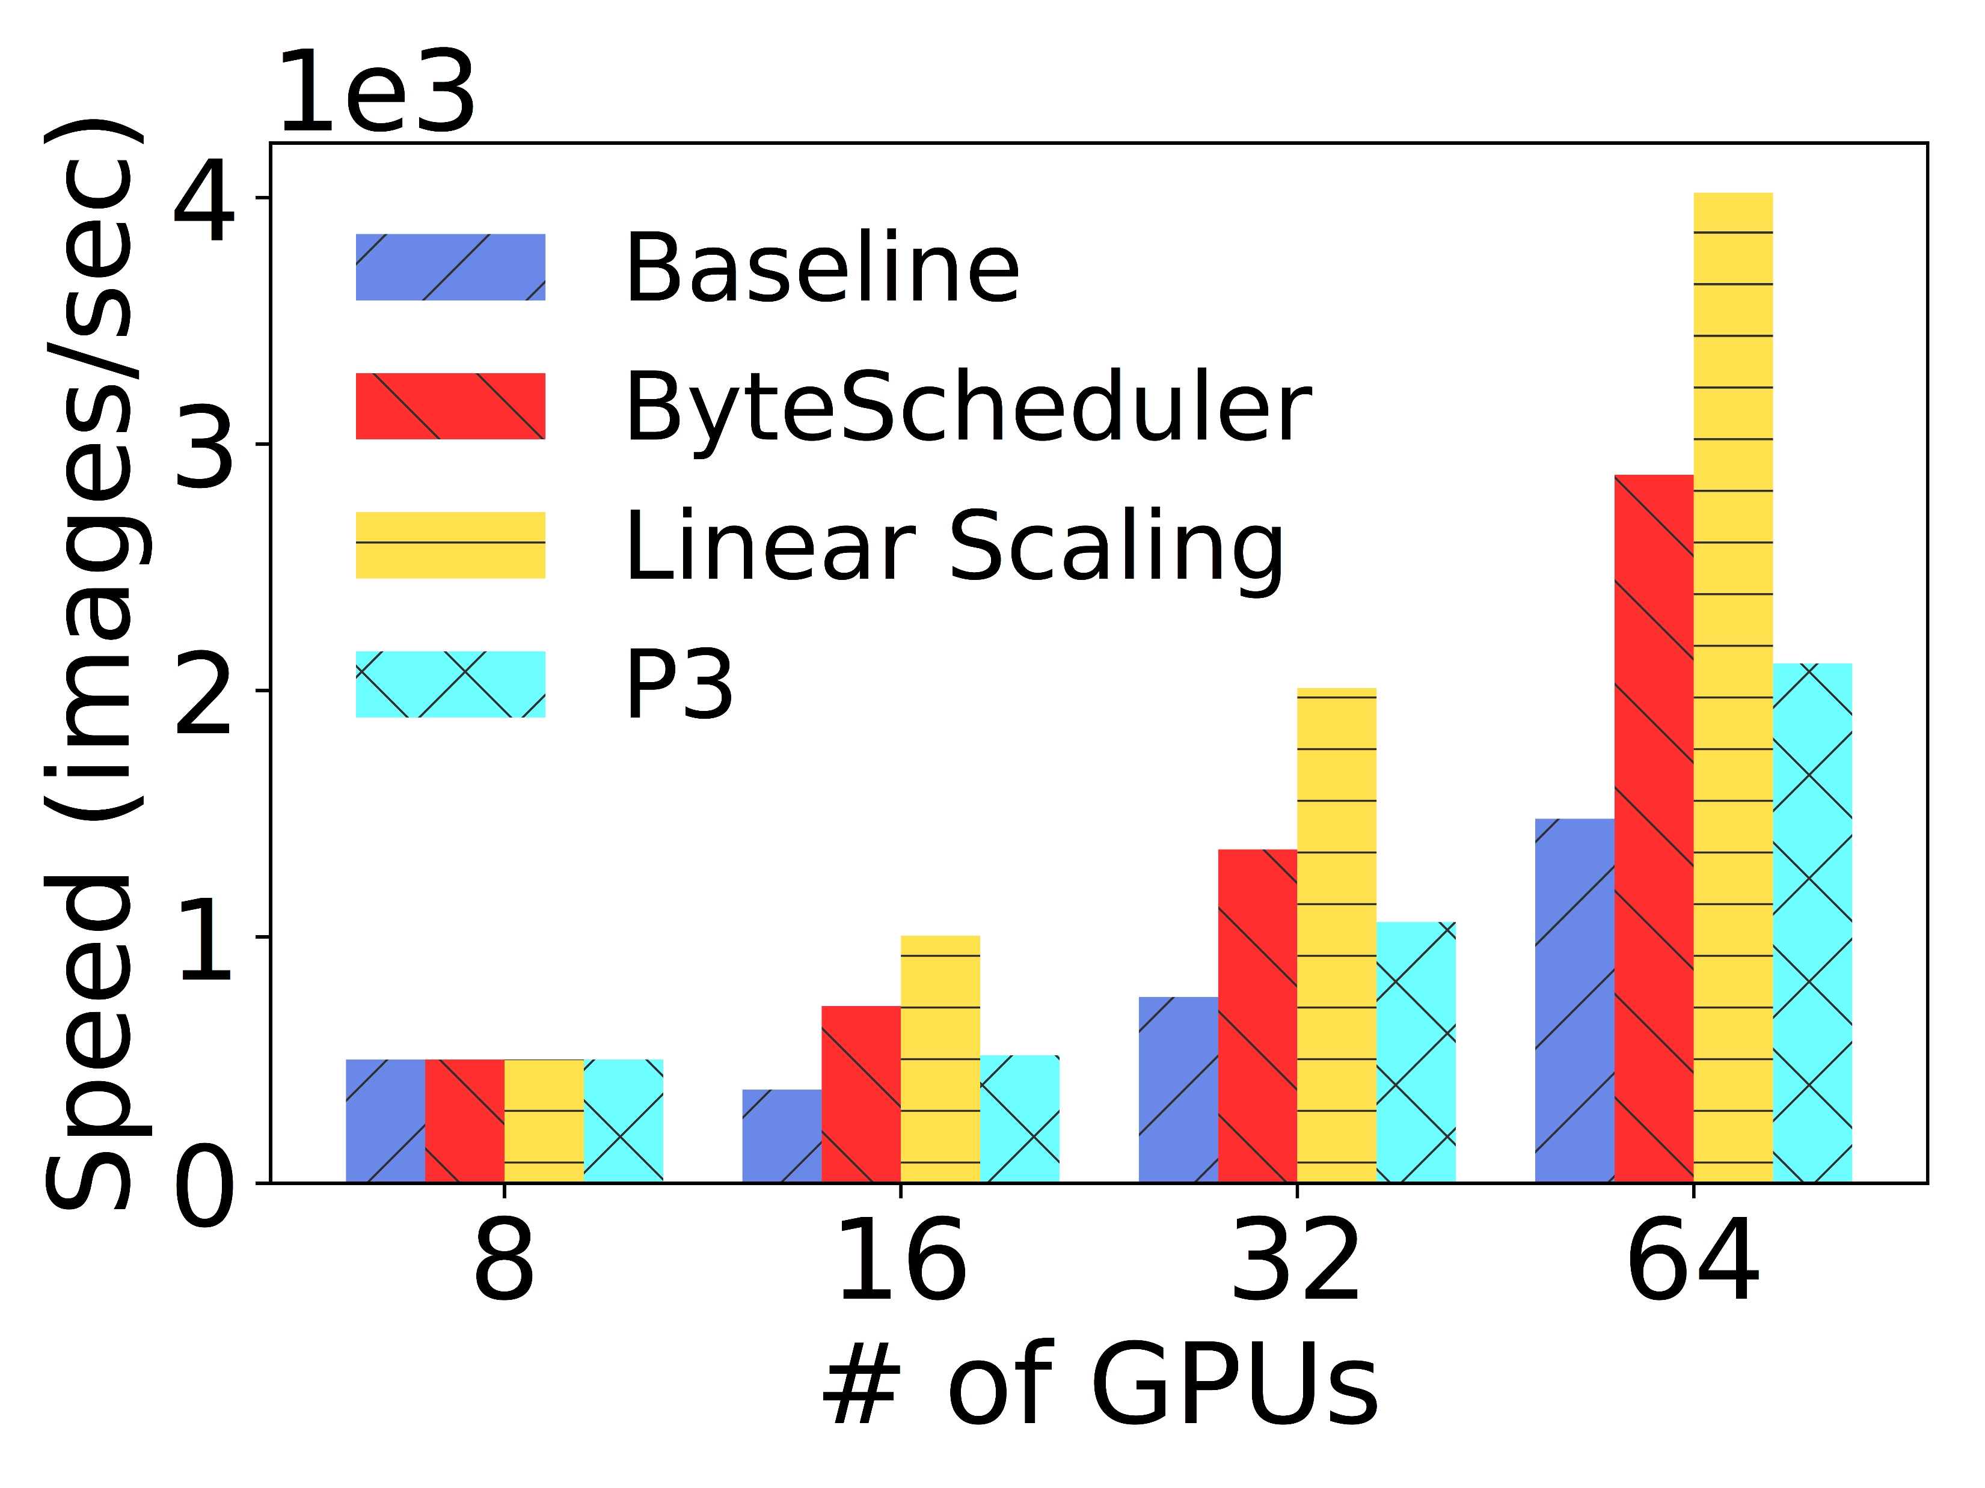
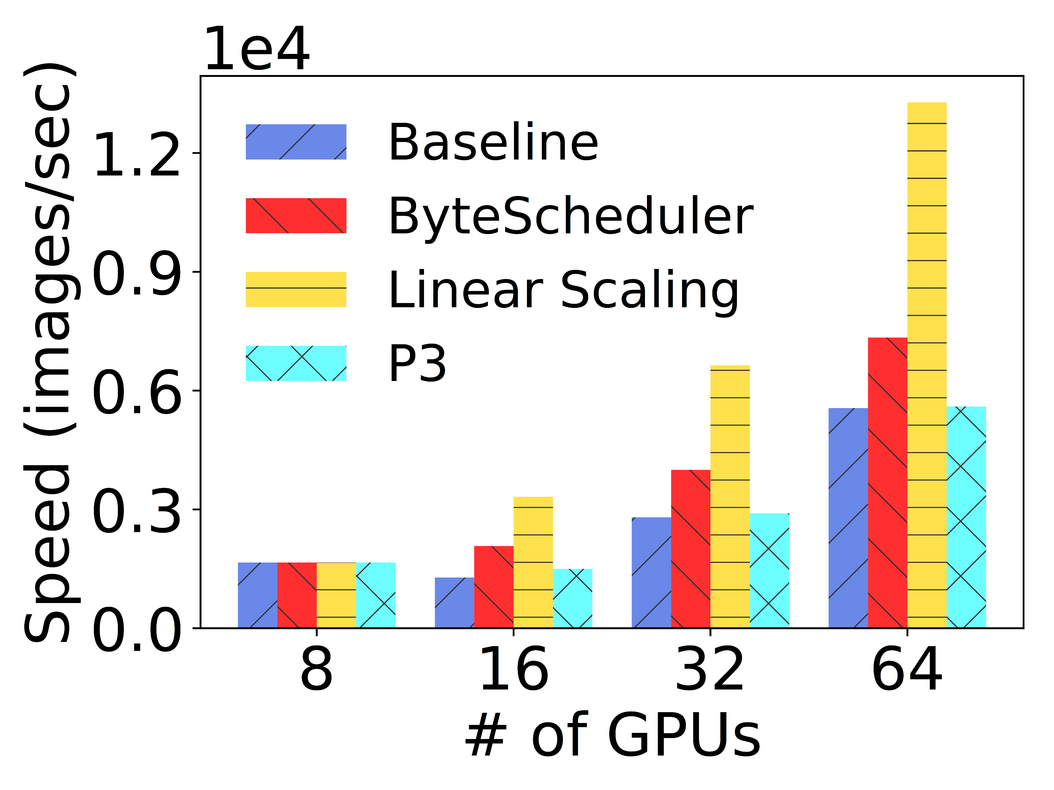
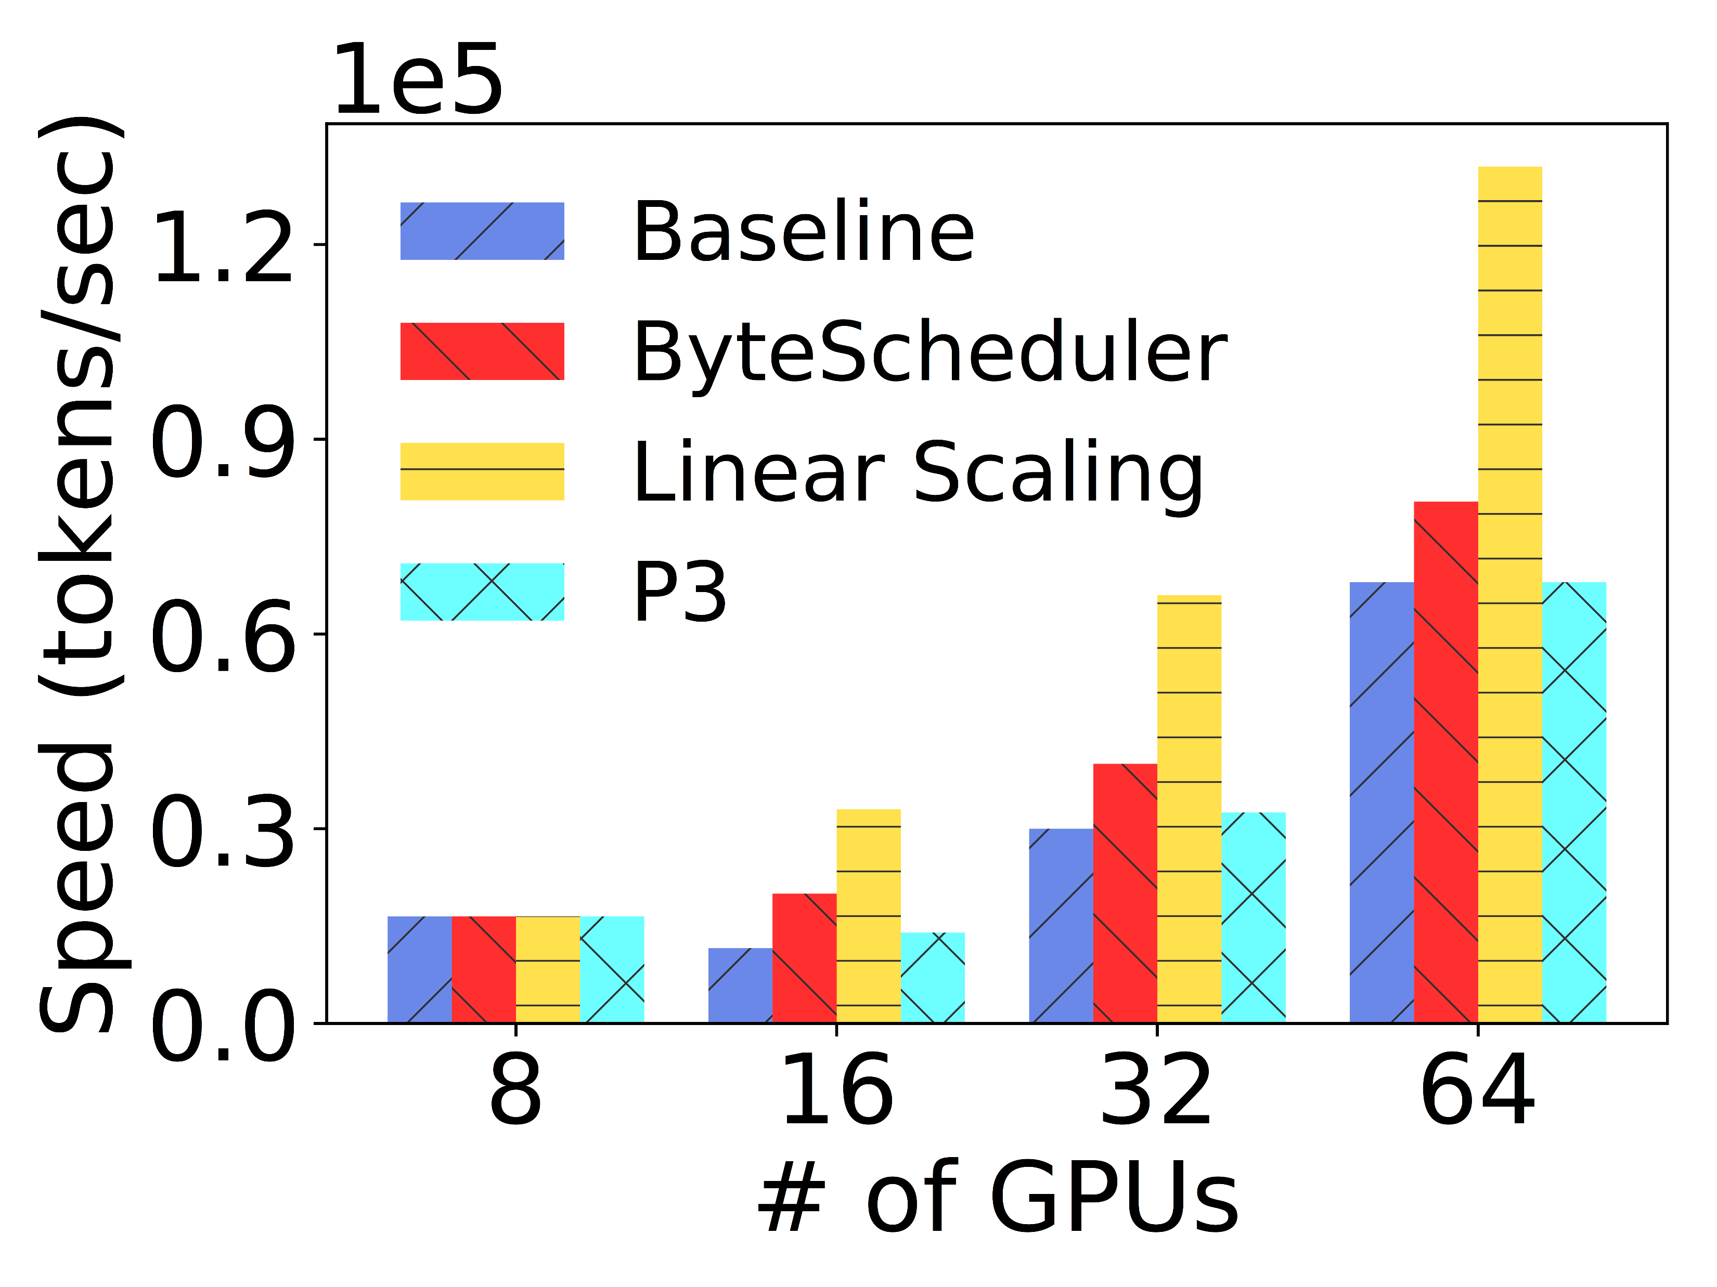
MXNet PS TCP
    VGG16 (80%-94%)
    ResNet50 (43%-62%)
    Transformer (33%-72%)
    43%-94% speedup compared to the baseline
    Outperform P3 by 28%-43%

Slide 40
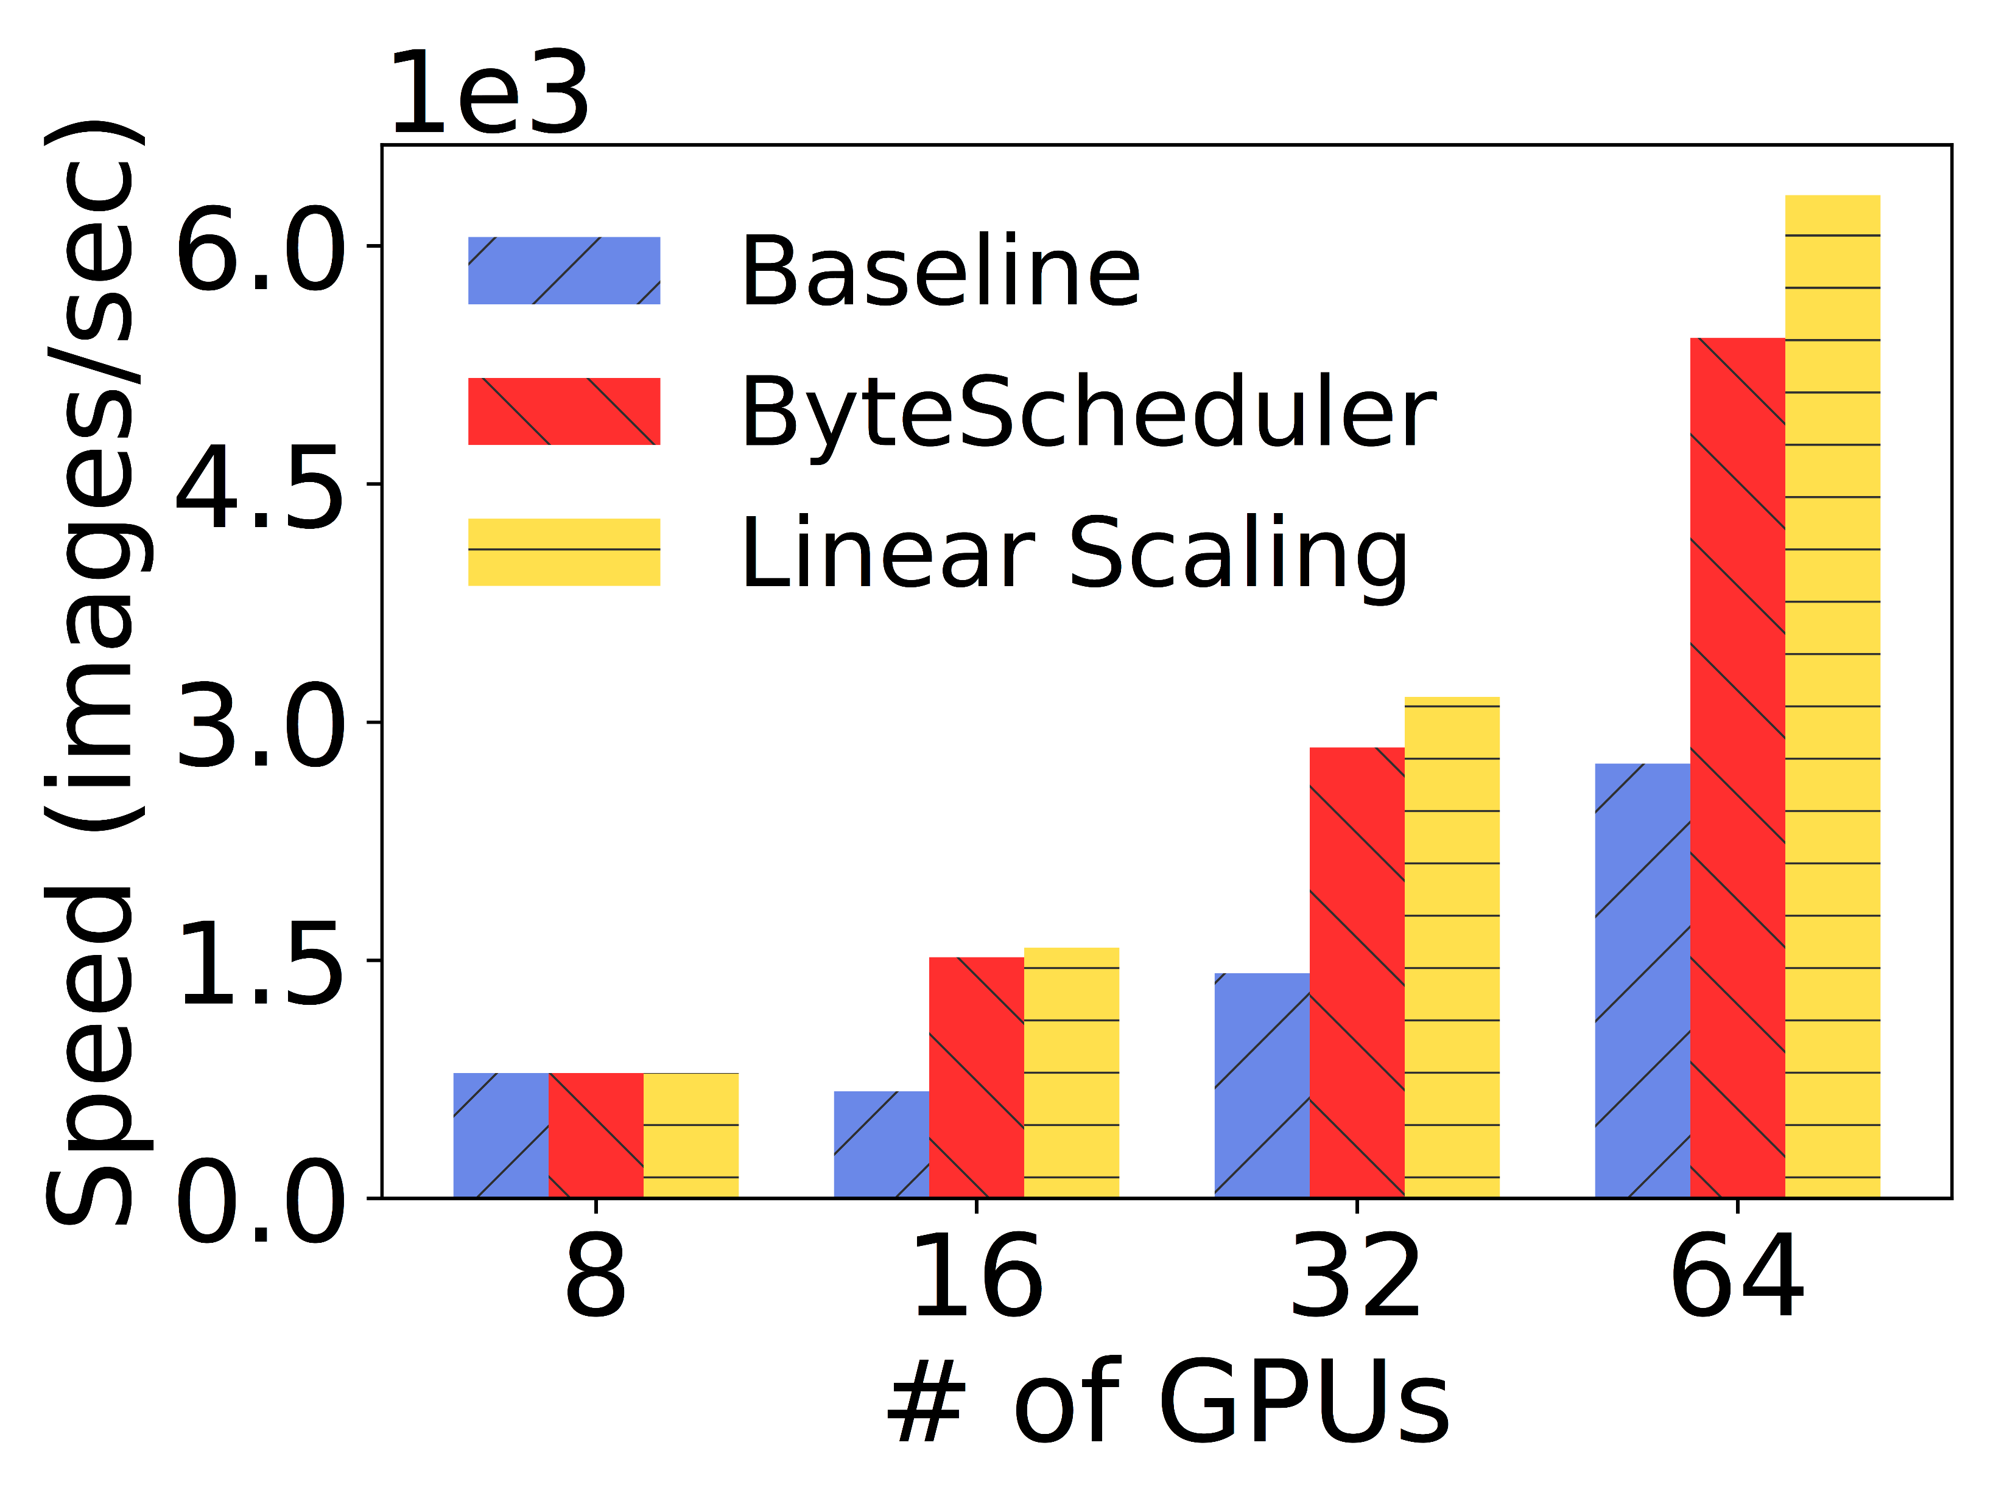
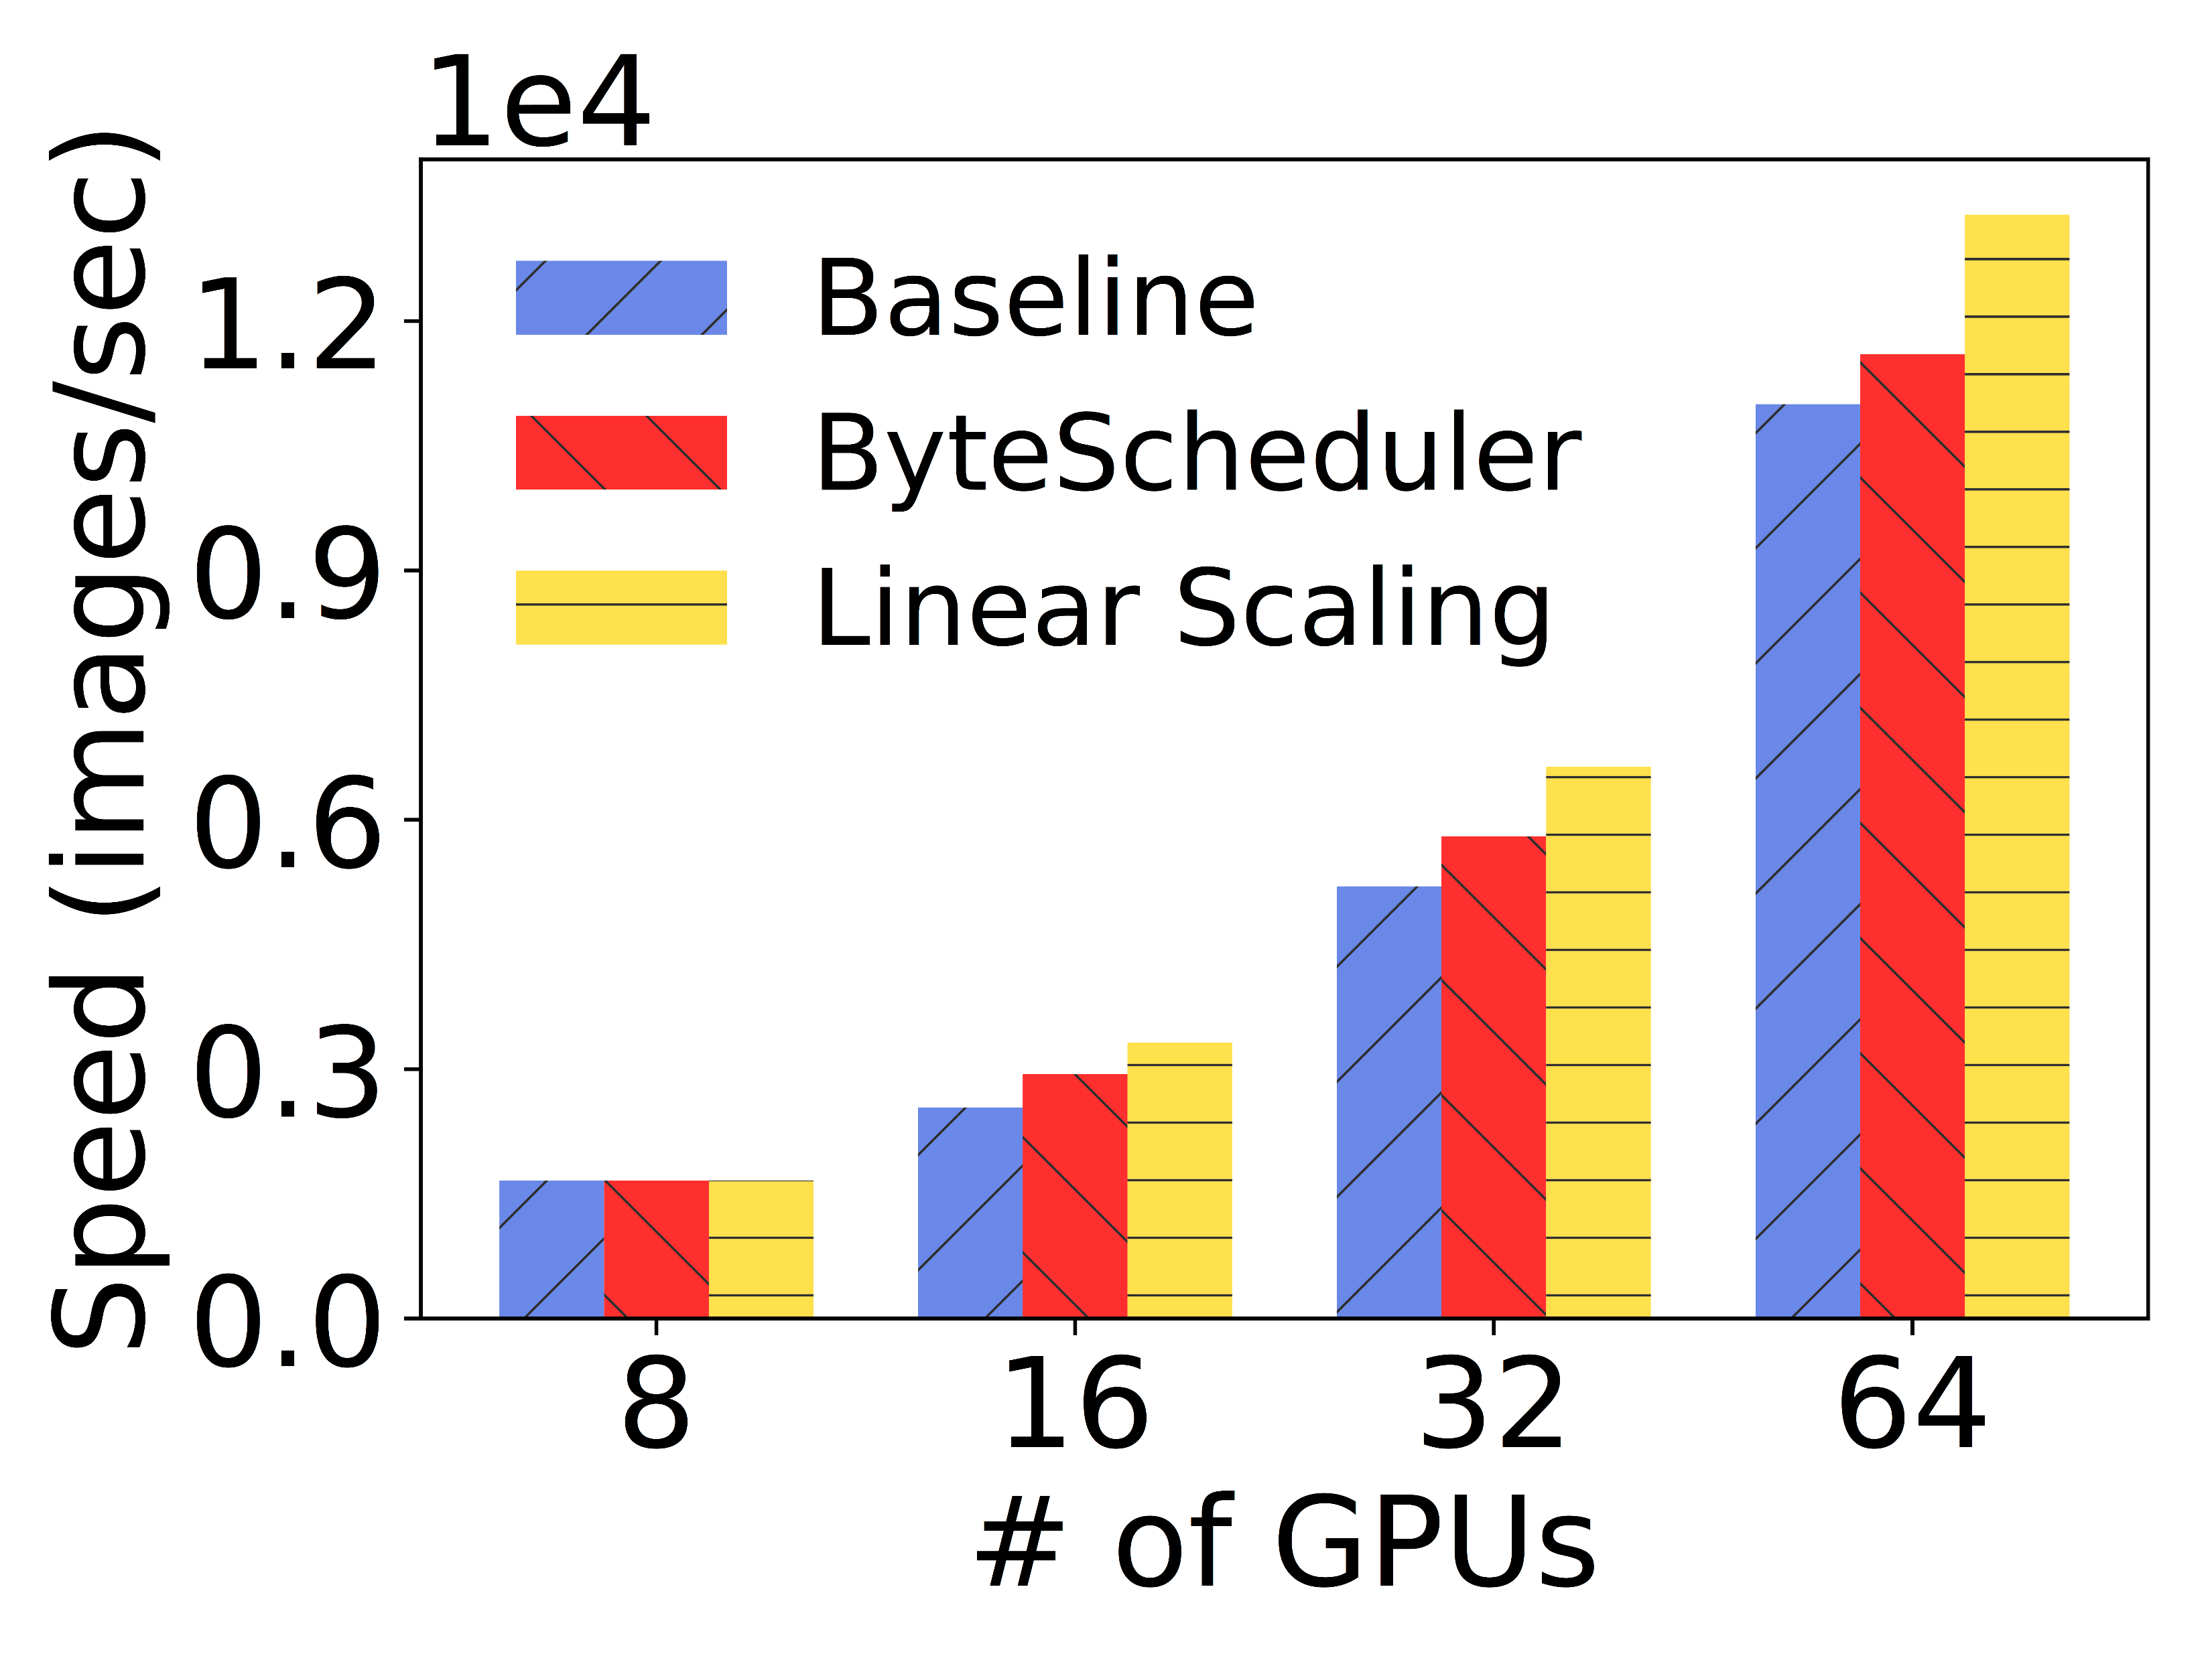
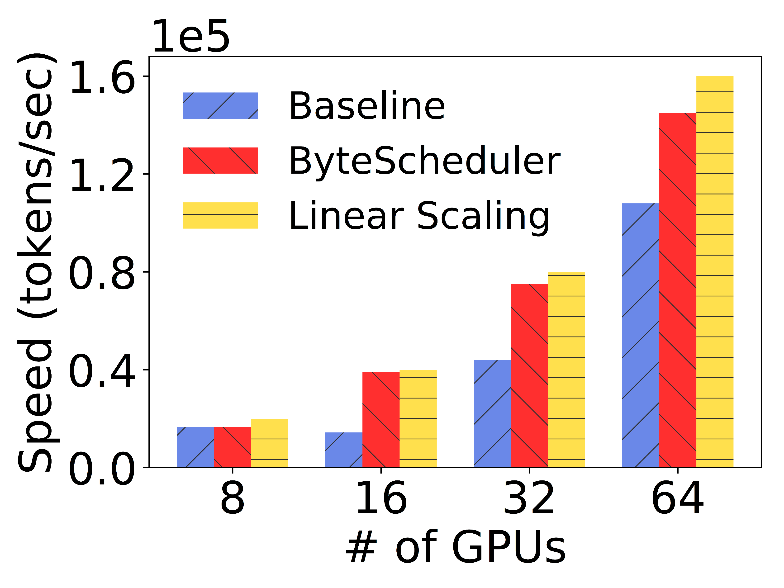
MXNet PS RDMA
    VGG16 (97%-125%)
    ResNet50 (9%-15%)
    Transformer (70%-171%)
    Up to 171% speedup compared to the baseline
    ResNet50 has smaller speedup due to less parameters

Slide 41
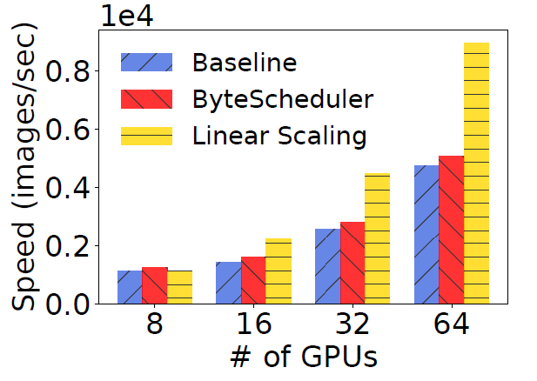
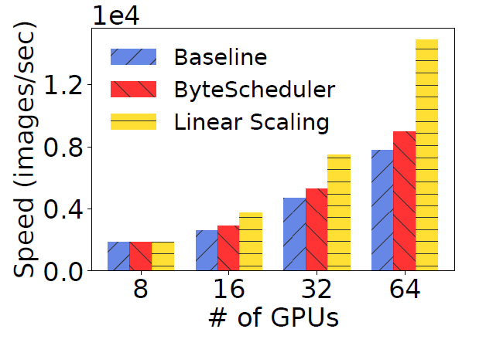
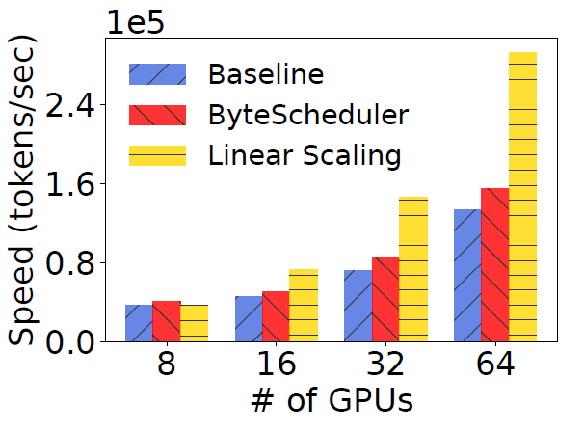
PyTorch NCCL TCP
    VGG16 (7%-13%)
    ResNet50 (11%-15%)
    Transformer (11%-18%)
    Acceleration for PyTorch NCCL is much smaller as NCCL already does tensor partition

Slide 42
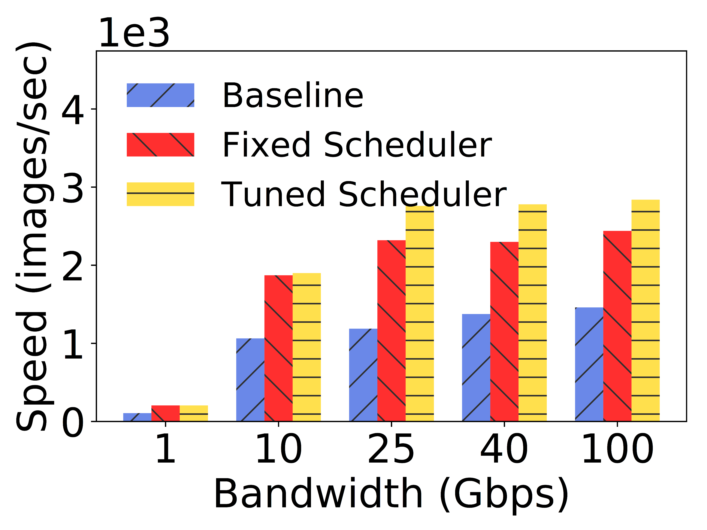
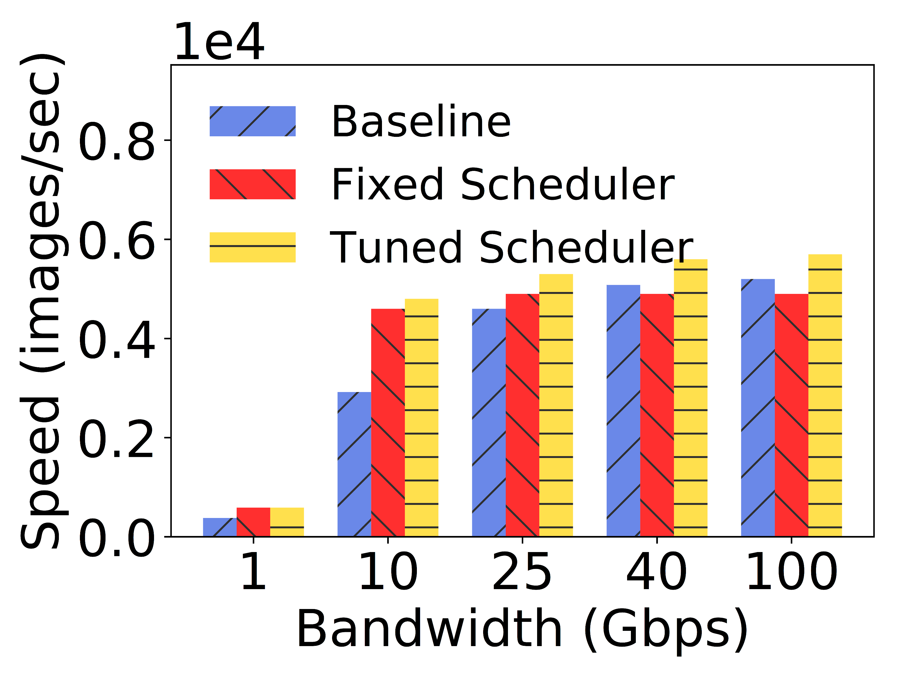
MXNet PS RDMA, Bandwidth
    VGG16 (79%-132%)
    ResNet50 (10%-64%)
    Transformer (67%-70%)
    Consistent speedup in all bandwidth settings. For ResNet50, the speedup stops when bandwidth is higher than 25Gbps
    Without auto-tuning, the training speed is lower than with it and even performs worse than baseline sometimes

Slide 43
Summary
ML system – standing on the shoulders of giants
Connecting the physical and digital worlds
Opportunities for system builders
Web
Browser
Mobile
Internet
Cloud
Computing
ML
system
PSTN
Cellular
TCP/IP
Windows
Linux
System

Slide 44
Acknowledgement
Thanks the interns and member of the ML System Group at Bytedance AI Lab!

Slide 45
Q&A
We are hiring!
  guochuanxiong@bytedance.com

