Slide 1

Systematic Communication Acceleration for Distributed DNN Training
Chuanxiong Guo
Distributed ML
Dec 7, 2021
Notes:
Abstract:
This talk discusses how to accelerate communication of distributed DNN training from the first principles of DNN model training. The objective of communication acceleration is to reduce training time under the same amount of GPU computation resources. We achieve this objective by systematically exploring the acceleration space in communication transport, scheduling, and topology. First, for communication transport, we use RDMA/RoCEv2 and address a set of engineering challenges to accelerate the tensor transmission speed. Second, for communication scheduling, we find the optimal way of overlapping communication and computation, so that the communication time can be hidden as much as possible. Third, for communication topology, we introduce a new framework which integrates Parameter Server and all-reduce as its two special cases. Our new framework achieves optimal network capacity whereas neither Parameter Server nor all-reduce can. We integrate all our findings in BytePS, which is open sourced.

Slide 2
Outline
DNN Background
Systematic Communication Acceleration
  High-speed communication transport: RDMA
  Hiding communication time: ByteScheduler
  Increasing network capacity: BytePS
Discussion
Notes:
part of dnn training, and a brief discussion on what’s next.

Slide 3
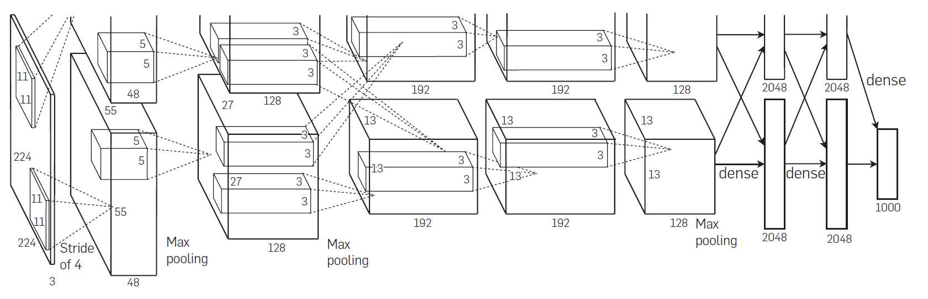


The DNN Breakthrough in 2012
Cat
AlexNet

Slide 4
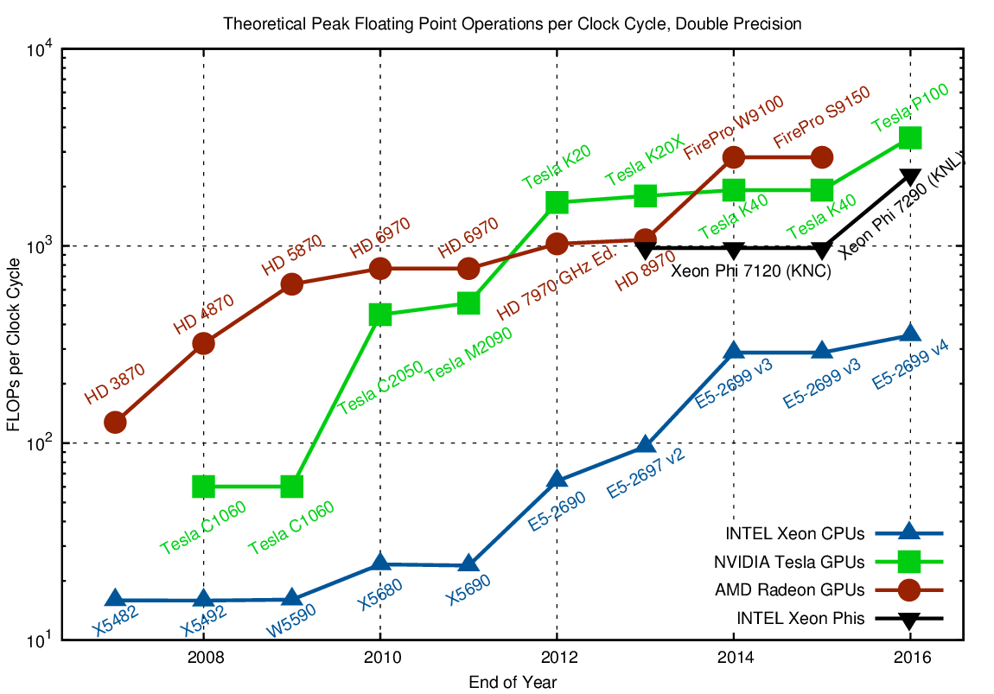
5 Years!
10 Years

Slide 5
Deep Neural Network (DNN)
DNN Models
ResNet-50
(26M params)
BERT-Large
(387M params)
GPT-3
(175B params)
DNN model | Device | Computation time (FP + BP) | Estimated #iters. to converge | Estimated training time
ResNet-50 | 1x Tesla V100 | 32ms + 64ms (batch size 32) | 3.6M | 96 hours
BERT-Large | 1x Tesla V100 | 339ms + 508ms (batch size 35) | 8M | 78.4 days
DNN
Training
Need distributed training to scale out!

Slide 6
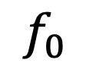


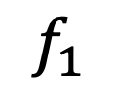






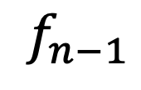









DNN Basics: Backprop
$$f_{0}$$
$$f_{1}$$
$$f_{n−1}$$
$$b_{n−1}$$
$$b_{1}$$
$$b_{0}$$
$$I_{0}$$
$$I_{1}$$
$$I_{n−1}$$
$$w_{0}$$
$$w_{1}$$
$$w_{n−1}$$
$$w_{n−1}$$
$$w_{1}$$
$$w_{0}$$
$${∇I}_{n−1}$$
$${∇I}_{1}$$
Three steps:
Forward propagation
Back propagation
Parameter update
$${∇w}_{n−1}$$
$${∇w}_{1}$$
$${∇w}_{0}$$

Slide 7



DNN Basic Computing Blocks
Forward propagation:
$$O=W×I$$
Back propagation:
$$∇W=∇O×I^{T}$$
$$∇I=W^{T}×∇O$$

Slide 8
Backprop based DNN Training
Epoch0
Epoch1
Epoch2
Epoch3
Epoch M
Training
Minibatch0
Minibatch1
Minibatch2
Minibatch N
Forward
Backward
f_0
f_1
…
f_{n-1}
b_{n-1}
b_{n-2}
…
b_0

Slide 9









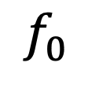

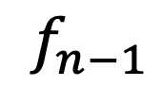

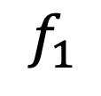
















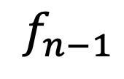


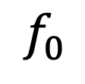
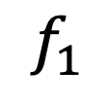





Distributed DNN Training
$$f_{0}$$
$$f_{1}$$
$$f_{n−1}$$
$$b_{n−1}$$
$$b_{1}$$
$$b_{0}$$
$$I_{0}$$
$$I_{1}$$
$$I_{n−1}$$
$$w_{0}$$
$$w_{1}$$
$$w_{n−1}$$
$$w_{n−1}$$
$$w_{1}$$
$$w_{0}$$
$${∇I}_{n−1}$$
$${∇I}_{1}$$
$${∇I}_{0}$$
$${∇w}_{n−1}$$
$${∇w}_{1}$$
$${∇w}_{0}$$
$$f_{0}$$
$$f_{1}$$
$$f_{n−1}$$
$$b_{n−1}$$
$$b_{1}$$
$$b_{0}$$
$$I_{0}$$
$$I_{1}$$
$$I_{n−1}$$
$$w_{0}$$
$$w_{1}$$
$$w_{n−1}$$
$$w_{n−1}$$
$$w_{1}$$
$$w_{0}$$
$${∇I}_{n−1}$$
$${∇I}_{1}$$
$${∇I}_{0}$$
$${∇w}_{n−1}$$
$${∇w}_{1}$$
$${∇w}_{0}$$
Notes:
Distributed training, using data parallelism as an example.

Slide 10
Distributed DNN Training
worker
worker
worker
worker
worker
Parameter Server (PS)
All-reduce

Slide 11
Systematic Communication Acceleration
High-speed communication transport: RDMA
Hide communication time: ByteScheduler
Increase network capacity: BytePS

Slide 12
RDMA
Remote Direct Memory Access (RDMA): Method of accessing memory on a remote system without interrupting the processing of the CPUs on that system
RDMA offloads packet processing protocols to the NIC
IBVerbs/NetDirect for RDMA programing
RDMA in Ethernet based data centers -- RoCEv2

Slide 13
RoCEv2: RDMA over Commodity Ethernet
RDMA app
RDMA app
User
RoCEv2 for Ethernet based data centers
DSCP-based PFC for lossless networking
DCQCN for flow-based congestion control
Huge engineering efforts to make it scalable and safe
RDMA verbs
RDMA verbs
TCP/IP
TCP/IP
Kernel
NIC driver
NIC driver
RDMA transport
RDMA transport
DMA
DMA
Hardware
IP
IP
Ethernet
Ethernet
Lossless network

Slide 14
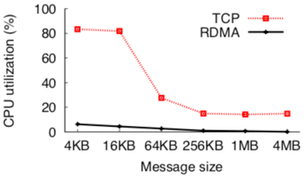
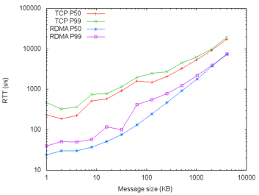
Using RDMA for Communication
RDMA NIC Offloading: ~0% CPU usage
RDMA Latency benefits (lower latency than TCP)
  Kernel bypassing
  Fast start / Lossless networking / ACK consolidation
~0% CPU Usage
Lower latency compared to TCP

Slide 15
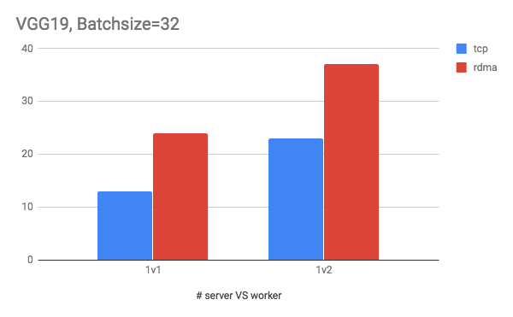
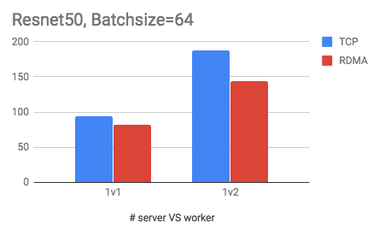
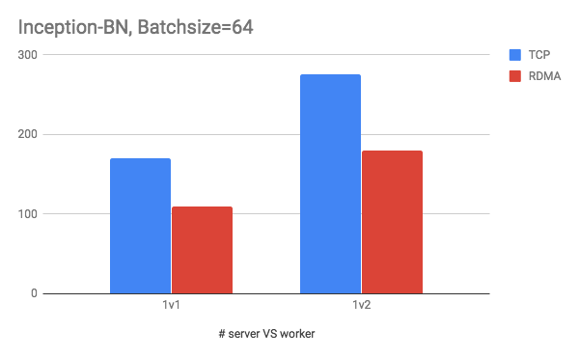
Vanilla RDMA Does Not Perform Well
For large models, vanilla RDMA outperforms TCP
  VGG19 has some large tensors (hundreds of MB), making the overhead not evident
For small models, vanilla RDMA is worse than TCP
  Resnet50 and Inception-BN have a lot of small tensors (most of them no more than 1MB)
  The overhead is larger than the benefit that RDMA brings

Slide 16
Optimizing RDMA for DNN Training
Our optimizations on RDMA performance
Tensor buffer memory reuse
Zero-copy RDMA data path
Address the Slow-Receiver Symptom

Slide 17
Tensor Buffer Memory Reuse
RDMA message needs to be registered before sent
Reuse the tensor memory region
  i.e., the sending buffer memory address can be reused
  we only need to do reg_mr once in the first training iteration, and reuse the memory in all the following iterations
  can benefit frameworks that decouple memory allocation with its communication library (e.g., MXNet & ps-lite)
iteration-0
compute
reg_mr
post_send
update
Vanilla
iteration-1
compute
reg_mr
post_send
update
iteration-0
compute
reg_mr
post_send
update
Optimized
iteration-1
compute
post_send
update

Slide 18
Tensor Buffer Memory Reuse
Reduce redundant rendezvous latency
  Rendezvous: get the remote buffer address to write the data
  With memory reuse, we only need Rendezvous once, and remove redundant rendezvous because the remote memory address does not change
sender
receiver
sender
receiver
1. Rendezvous Start
1. Rendezvous Start
2. Rendezvous Reply
Remove repeated rendezvous
2. Rendezvous Reply
3. Data RDMA-write
3. Data RDMA-write
Vanilla
Optimized

Slide 19
Zero-copy RDMA Data Path
There exists several memory copy ops on the data path
  Worker sends push requests to server, server copies the result to CPU buffer
  Server sends pull responses to worker, worker copies to CPU buffer
Memory copy decreases performance
  Single-threaded memcpy bandwidth: ~40Gbps
  Memcpy significantly decreases RDMA bandwidth utilization
We remove all memcpy on RDMA data-path, and achieve zero-copy communication

Slide 20
Address the Slow-Receiver Symptom
Problem 1: RDMA loopback traffic creates internal incast
Use shared memory to eliminate loopback traffic
Loopback
2:1 incast!
Memory
RX
Problem 2: the DMA write can be slow
  Use page-aligned buffers to reduce the # pages to be written
Problem 3: the RX can be impacted by the concurrent TX (not duplex)
  Without TX, the RX works well; With TX, the RX cannot reach line rate
  Use page-aligned sending buffers and enforce only one SGE per RDMA write

Slide 21
RDMA Next Steps
Cloud scale
  Lossy infrastructure
  Improved congestion control
Easier to program
Integrating with ML operators and hardware

Slide 22
Systematic Communication Acceleration
High-speed communication transport: RDMA
Hide communication time: ByteScheduler
Increase network capacity: BytePS

Slide 23
Dependency Graph
      Dependency:
      Backward depends on forward
      Push depends on backward
      Pull depends on push
      Forward depends on pull

Slide 24
Scheduling the Tensor Transmission Order
ML framework executes communication operations in FIFO order
Problem: FIFO strategy delays push and pull of layer 0 and hence delays the start of next iteration
Priority scheduling: layer i with higher priority than j for i < j

Slide 25
Priority Scheduling and Tensor Partitioning
In this example, priority scheduling and tensor partition result in 44% speedup

Slide 26
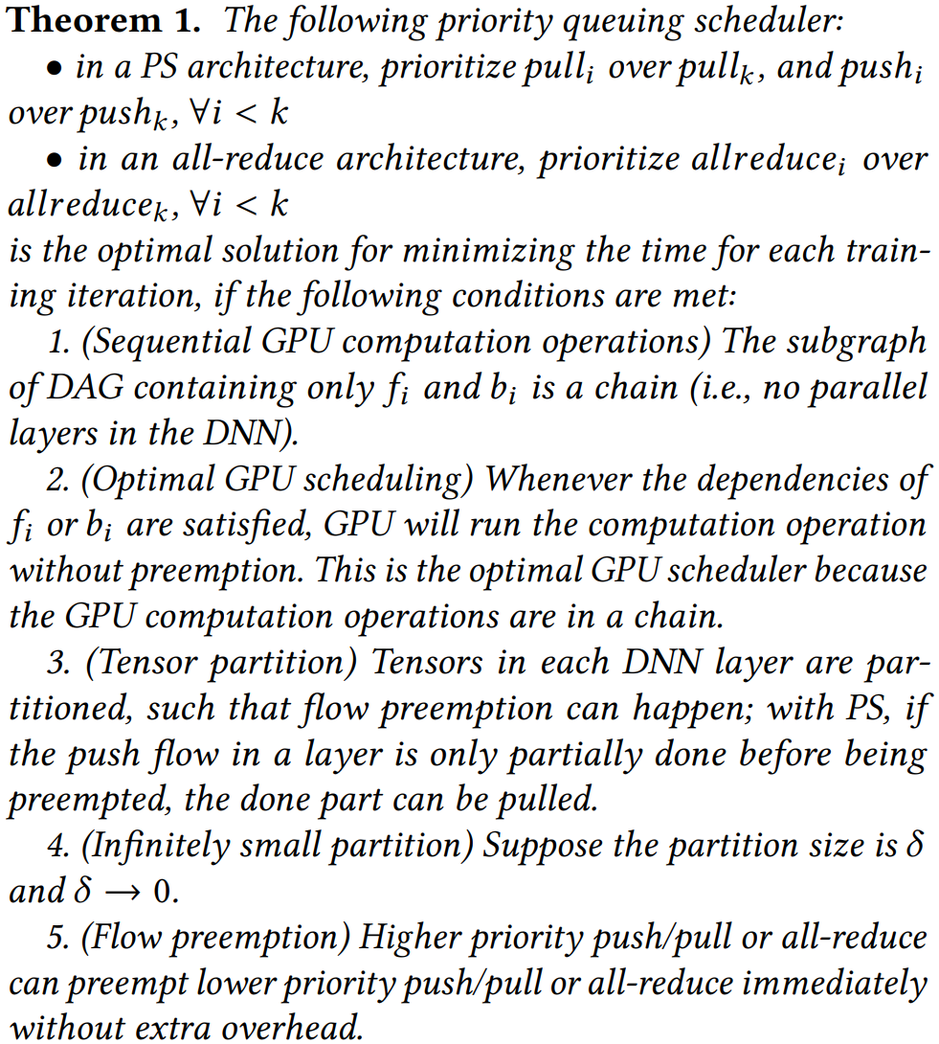
Priority Scheduling and Tensor Partitioning
Tensor partitioning reduces an NP-hard problem to an easy problem
Tensor partitioning was first introduced in P3 and TicTac
ByteScheduler overlaps communication and computation perfectly

Slide 27
ByteScheduler: One Generic Scheduler for ALL
Dependency graphs have similar structure for different ML frameworks, DNN models and communication methods (PS or all-reduce, TCP or RDMA)
We aim to design a generic scheduler, no matter which ML framework and communication method.
Challenges addressed in ByteScheduler:
Many training frameworks: TensorFlow, PyTorch, MxNet, etc.
Imperative engines (e.g., PyTorch) and declarative engines (e.g., TensorFlow)
Global barrier between iterations (e.g., TensorFlow, PyTorch)

Slide 28
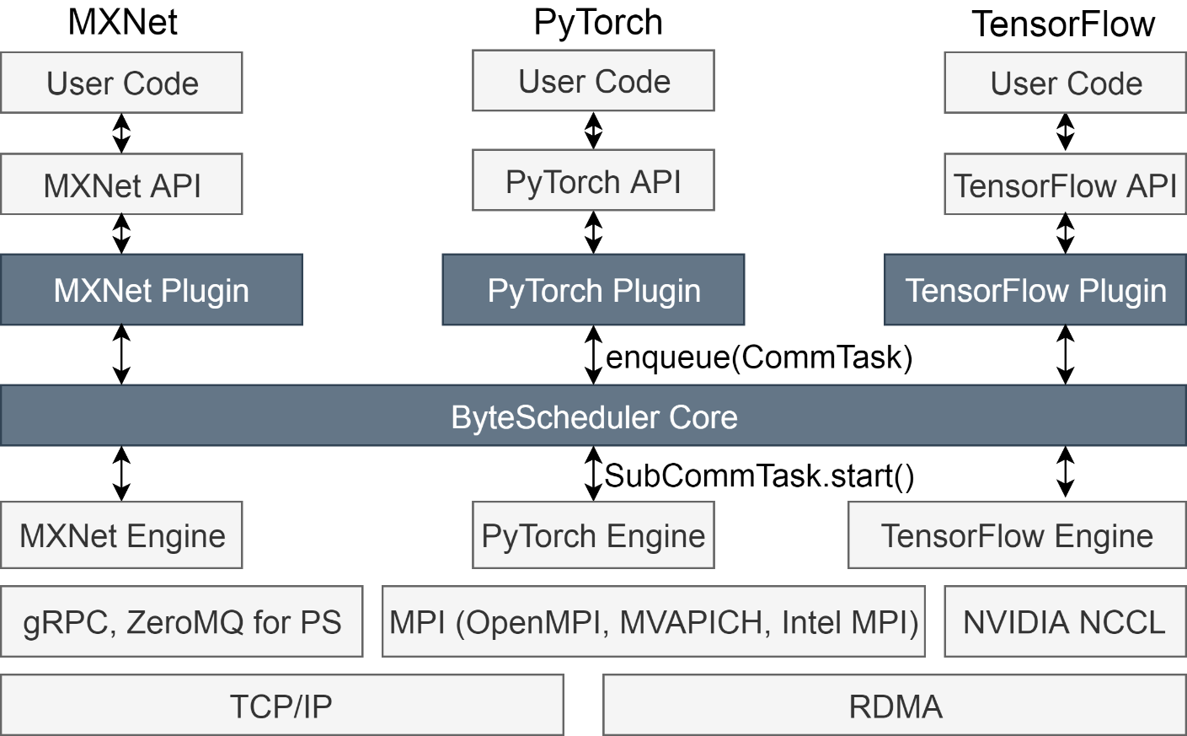
ByteScheduler Architecture
Plugin: Wrap each communication operation as a CommTask
Core: Partition and schedule CommTasks

Slide 29
Systematic Communication Acceleration
High-speed communication transport: RDMA
Hide communication time: ByteScheduler
Increase network capacity: BytePS

Slide 30
The Problem: Sub-optimal Inter-machine Communication
Heterogeneous Clusters
If use all-reduce → cannot leverage CPU machines
GPU Machines
If use PS → may create traffic hotspot when CPU not enough
CPU Machines
Existing solutions fail to leverage the heterogeneity of GPU clusters

Slide 31



BytePS for Inter-machine Communication
PS only uses links between GPU-CPU
All-reduce only uses links between GPUs
CPU
Machine
CPU
Machine
CPU
Machine
CPU
Machine
B
B
GPU Machine
GPU Machine
GPU Machine
GPU Machine
GPU Machine
GPU Machine
$$\frac{2B}{3}$$
$$\frac{2B}{3}$$
$$\frac{2B}{3}$$
CPU Bandwidth not utilized at all
Best strategy: combine together
Bandwidth not saturated
CPU
Machine
CPU
Machine
How to partition the link workload?
GPU Machine
GPU Machine
GPU Machine

Slide 32
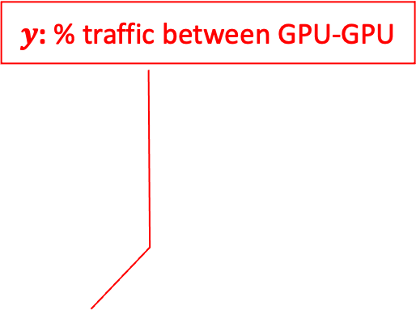
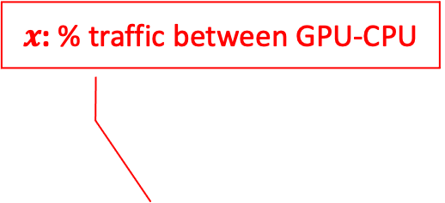
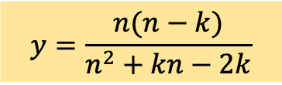
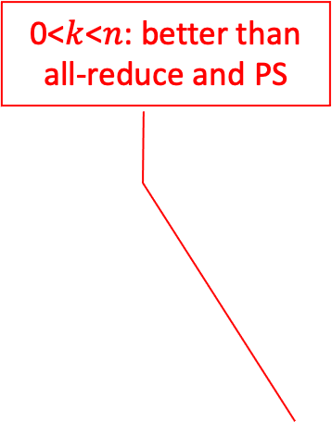
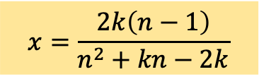
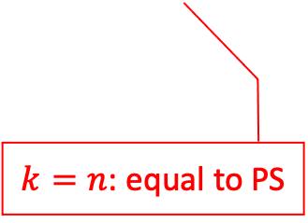
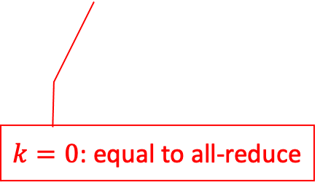
BytePS’ Best Partition Strategy
$x$: % traffic between GPU-CPU
$y$: % traffic between GPU-GPU
0<$k$<$n$: better than all-reduce and PS
CPU
Machine
CPU
Machine
GPU Machine
GPU Machine
GPU Machine
Optimal partition strategy:
$$x=\frac{2k\left(n−1\right)}{n^{2}+kn−2k}$$
$$y=\frac{n(n−k)}{n^{2}+kn−2k}$$
n: # of GPU machines k: # of CPU machines
$k=0$: equal to all-reduce
$k=n$: equal to PS
This strategy unifies PS and all-reduce, and is optimal with any # of CPU machines

Slide 33
BytePS Usage and Deployment
BytePS supports TensorFlow, PyTorch and MXNet
Easy to use: compatible to most widely used APIs
  Horovod-alike APIs
  Native APIs for PyTorch and TensorFlow
  BytePS is widely used in ByteDance
BytePS Core
https://github.com/bytedance/byteps

Slide 34
Evaluation Setup
Item | Content
CV models | ResNet-50 (TF), VGG-16 (MXNet), UGATIT-GAN (PyTorch)
NLP models | Transformer (TF), BERT-Large (MXNet), GPT-2 (PyTorch)
Hardware | Each machine with 8x V100 GPUs (32GB) and a 100GbE NIC
Network | RoCEv2, full-bisection bandwidth
Baseline | Horovod, PyTorch DDP, Native-PS of TF and MXNet
All experiments are performed on production clusters
All chosen models are representative of production workloads

Slide 35
End-to-end Scalability (up to 256 GPUs)
TensorFlow ResNet-50
MXNet VGG-16
PyTorch UGATIT-GAN
CV Models
TensorFlow Transformer
MXNet BERT-Large
PyTorch GPT-2
NLP Models
BytePS outperforms all-reduce and PS by up to 84% and 245%, respectively

Slide 36
Outline
DNN Background
Systematic Communication Acceleration
  High-speed communication transport: RDMA
  Hiding communication time: ByteScheduler
  Increasing network capacity: BytePS
Discussion

Slide 37
Discussion
Distributed training: scale and cost
  Data parallelism: cannot handle big models
  Model parallelism: needs large memory and high bandwidth, does not scale
  Pipeline parallelism: efficiency is low
  auto parallelism: integrating the best of the three parallelisms, automatically

Slide 38
Discussion
Future proof ML hardware and interconnects
  GPU vs DSA
  NVLink vs Ethernet
  RDMA vs proprietary protocols
  Clos network vs direct network

Slide 39
Summary
BytePS
  RDMA for tensor communication acceleration
  ByteScheduler: optimal communication and computation overlapped tensor scheduler
  BytePS: unifying all-reduce and PS
ML systems opportunities
  Distributed training: scale and cost
  New hardware and network for higher efficiency and lower TCO
Web
Browser
Mobile
Internet
Cloud
Computing
ML
system
PSTN
Cellular
TCP/IP
Windows
Linux

Slide 40
Acknowledgement
Yimin Jiang, Yibo Zhu, Chang Lan, Bairen Yi, Yong Cui, Chuanxiong Guo: A Unified Architecture for Accelerating Distributed DNN Training in Heterogeneous GPU/CPU Clusters . OSDI 2020.
Yanghua Peng, Yibo Zhu, Yangrui Chen, Yixin Bao, Bairen Yi, Chang Lan, Chuan Wu, Chuanxiong Guo: A Generic Communication Scheduler for Distributed DNN Training Acceleration. SOSP 2019.
Thank the members of the ByteDance ML System team

